Slide 1
Grand Rounds 2011
Presented Macon, GA
by Joe Sam Robinson, Jr., M.D.

Slide 2
Towards a New Paradigm for the American Healthcare System
Joe Sam Robinson Jr

Slide 3

Purpose of the Presentation
To discuss some of the problems that bedeviled the American healthcare System:
Why these problems exist?
What could be done in way of improvement?

Slide 4
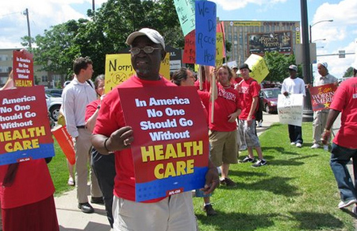
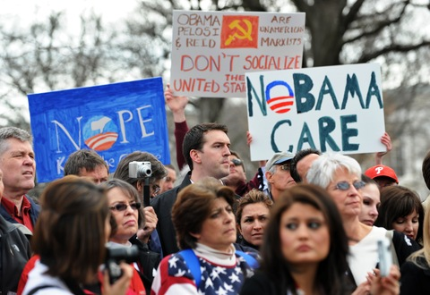
U.S. Healthcare Crisis
People demonstrate against the health care reform bill last year in Washington. Photo by Jewel Samad/AFP/Getty Images.
Health care reform supporters in Minnesota. (Photo: AFL-CIO/Flickr).

Slide 5
Examples of Dysfunction of the American Healthcare System
Physician maldistribution
Uneven technology access
Deficient care in disadvantaged areas
Increased paperwork requirements
Excessive reliance on emergency care
Hospitals and emergency transfers often suboptimal
High costs
Overuse of care in some circumstances
Inadequate prevention schemes
Absence of patient responsibility

Slide 6
Some good things too:
30 years additional life expectancy
Best high-tech healthcare system in the world
Highest amount of biomedical research in the world
Most quoted biomedical papers and clinical practice guidelines in the world
A major employer in a time of unemployment difficulties

Slide 7
Moreover comparative statistics demonizing the American Healthcare System often faulted For instance:
High infant mortality in USA (6.9 per 1000 in 2003-05). The quality of a country's documentation of perinatal mortality matter greatly to the accuracy of its infant mortality statistics. In some countries, infants who die in the first 24 hours are misreported as stillbirths rather than infant deaths. Those countries do not follow WHO recommendations for the reporting of live births and infant deaths.
High obesity rate in USA is not considered as a variable that affects healthcare outcome and life expectancy.

Slide 8
Also, burdens of social dysfunction which guarantee some degree of inefficiency are increasingly cast on the healthcare system
Unregistered aliens (7-20 million)
Increase in prison population (2 million)
Increase in violence (5 murders per 100,000)
Illicit drug addiction (10-15%)
Increase in illegitimacy (32-35%)
Increase in people on disability (10.4% for persons ages 21 to 64)
Decline in church attendance (43%)

Slide 9
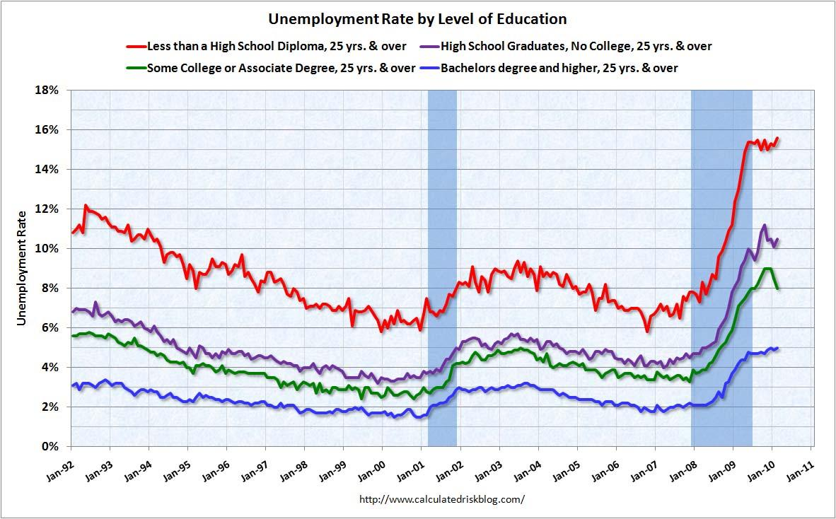
No country for old men or those lacking skills

Slide 11
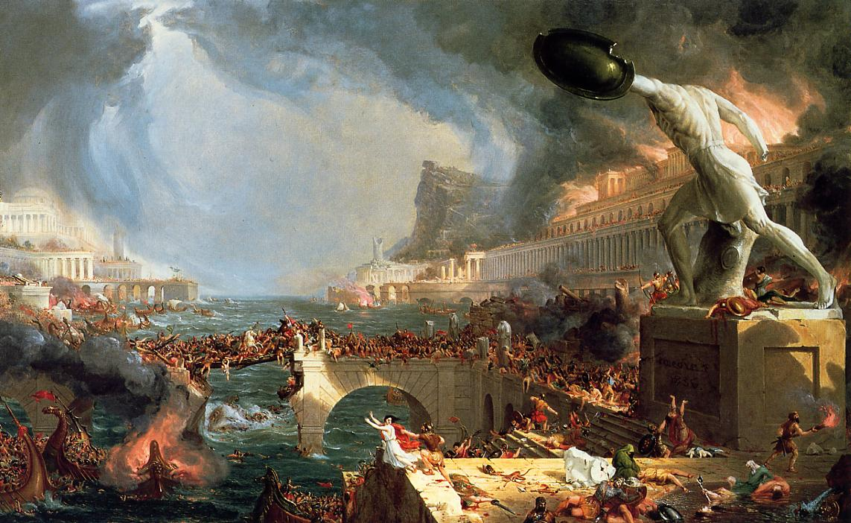
Why the Roman walls were breached

Slide 12
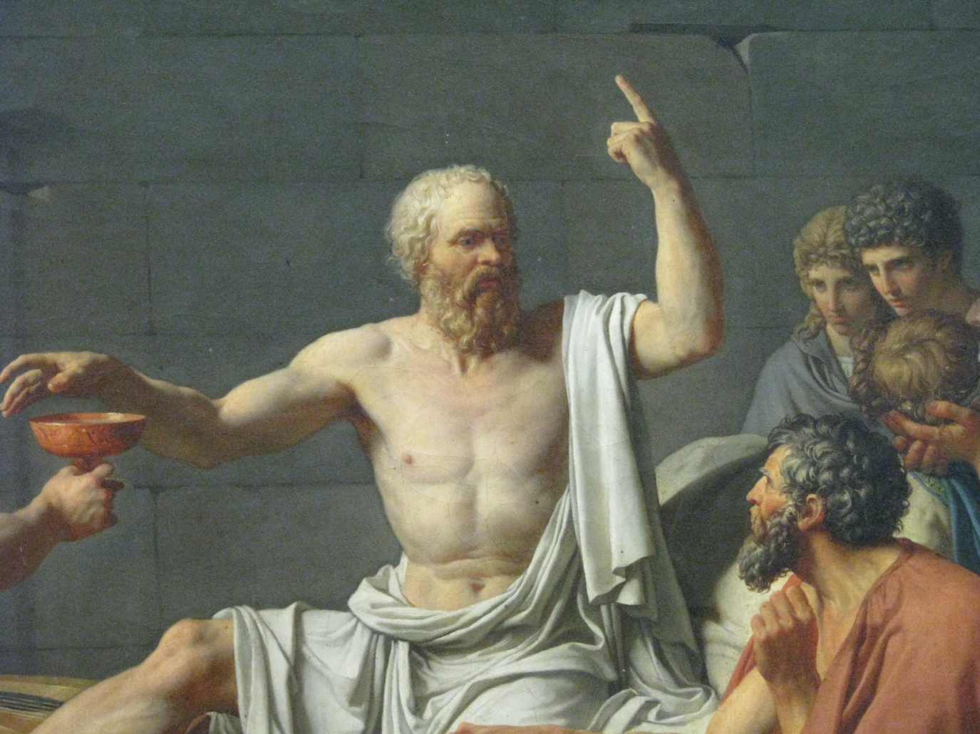
The deep roots of the problem The evolution of the individual-government relationship

Slide 13

No man is an island entire of itself; every man is a piece of the continent, a part of the main.
John Donne 1624

Slide 14
Likewise, with the American healthcare system:
The American healthcare system is not separate from the main but is an integral part of the very fabric of the American culture and civilization.
The changes that the healthcare system is facing have an explanation in historical chronology of the American geopolitical system.
Understanding shortfalls and possibilities for corrective improvement of the American healthcare system would be further confirmation of American Exceptionalism.

Slide 15
The Central Place of Healthcare in the Dynamically Changing American Civilization
Social ∆
Healthcare
∆
Political ∆
Economic ∆

Slide 16

The Birth Certificate of the United States of America

Slide 17
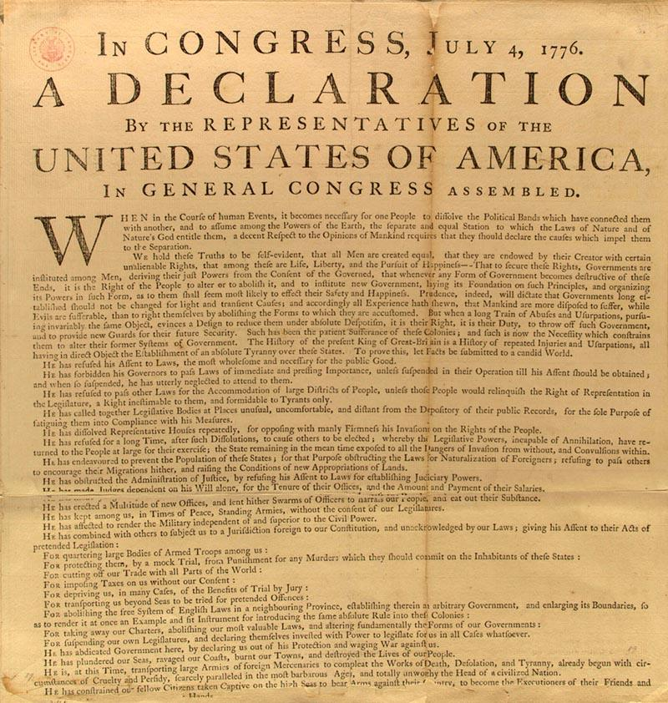
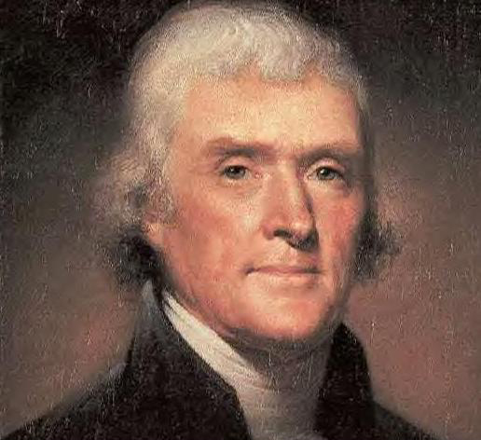
We hold these truths to be self-evident, that all men are created equal, that they are endowed by their Creator with certain unalienable Rights, that among these are Life, Liberty and the pursuit of Happiness.*
* A difficult sentence to parse!

Slide 18
The Declaration of Independence – An Incomplete Politically-Incorrect Document?
Native Americans referred to as “merciless Indian Savages”
No mention of slavery even though 25% of the population was in bondage
No reference to women’s right to vote. Indeed, Jefferson refers to “manly firmness”
Everywhere, suffrage was restricted by tax-paying abilities. The old English rule, to vote one had to pay at least 20 schillings land tax.
Equal rights to “life, liberty, pursuit of happiness and equality” in a state of nature are difficult to maintain in the state of nature without significant government intervention evening the playing field
No mention of the responsibility of the recipient individual as to the judicious execise of these “uninaliable rights” or the overextension of these rights which may lead to a state of theological sin

Slide 19

Since 1776 Our Nation has Undergone Extensive Transformation Requiring Evolutionary Political Change

Slide 20
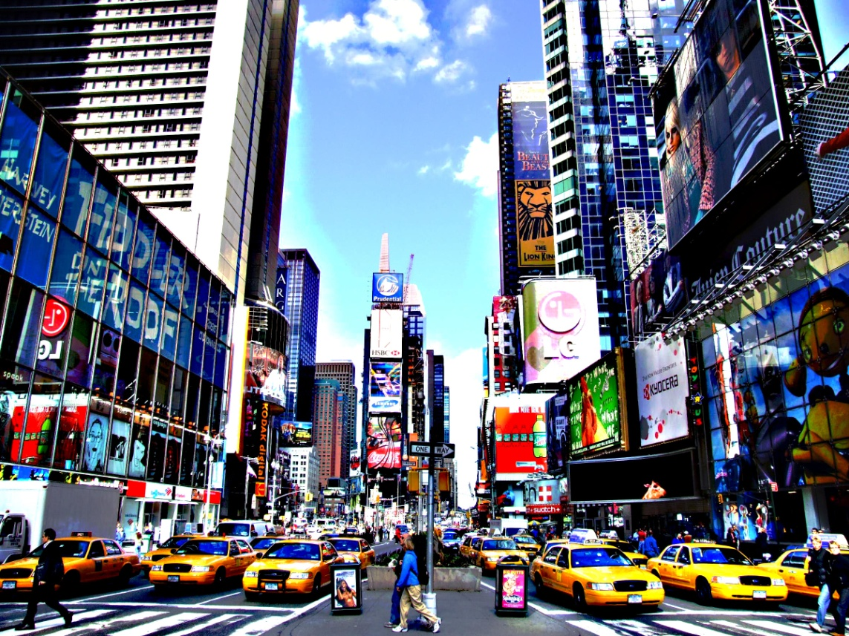
X100 population increase
30 years additional longevity
Extensive Urbanization
Post-industrialization workforce
Advanced technology
More powerful business cycle
“Winner takes all” Capitalism
Cultural diversity and social transformation
Rapid transportation and communication
Globalization

Slide 21


1776
The relief of the frontier
2012
Life in a submarine

Slide 22


This is not the Krebs Cycle
Charlemagne was crowned Holy Roman Emperor by Pope Leo III
The Divine Right of Kings
King Henry VIII's becomes head of the church of England
The Moral Imperative of Democracy
Declaration of Independence
1776 AD
1787 AD
1868 AD
1913 AD
1920 AD
1965 AD
1995 AD
2010 AD
Patient Protection and Affordable Care Act
US Constitution Separation of Powers Checks & Balances
Health Insurance Portability and Accountability Act
14th Amendment – Citizenship Rights
Social Security Act (Medicare & Medicaid)
16th Amendment – Income Tax
19th Amendment – Women’s Suffrage

Slide 23
Definition of the Democratic Moral Imperative
The government possesses paramount power given to it by the people through voter affirmation often tainted by sophistry to redistribute wealth, correct and manipulate the free market, protect the weak against the mighty, and thus to obtain equal and by some lights fair enjoyment of “life, liberty and the pursuit of happiness” under the aegis of the government.

Slide 24

How did this incomplete transformation toward the Democratic Moral Imperative occur?

Slide 25
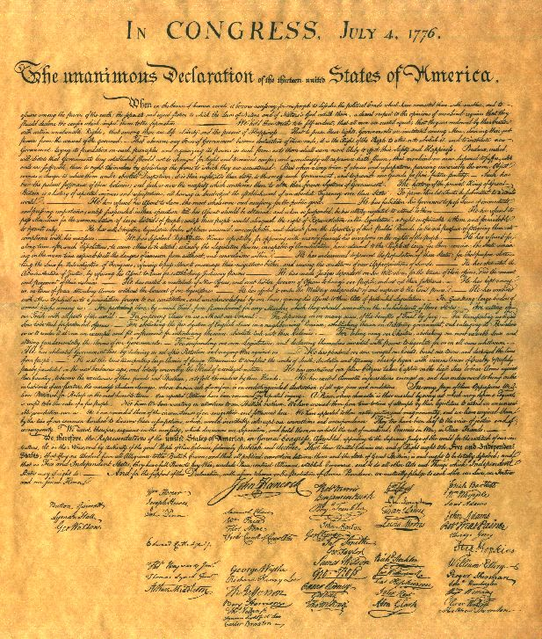
Not the United States Constitution
Aggregation of government power to become the arbiter of life, liberty and pursuit of happiness came largely outside constitutional parameters. Moreover, the constitution guarantees a republican form of government, not a democratic form.

Slide 26
Constitution Amendments
22 restricted government power
4 broadened electorate and enhanced democracy
2 increased government power (1 repealed)

Slide 27
1. Executive Leadership

Slide 28
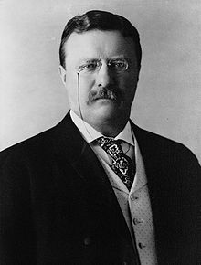
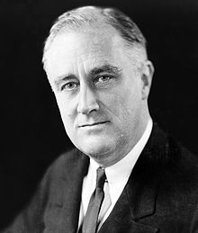
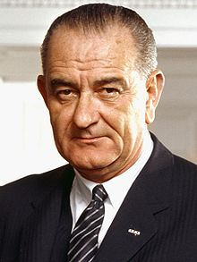
Theodore Roosevelt
Franklin Roosevelt
Lyndon johnson

Slide 29
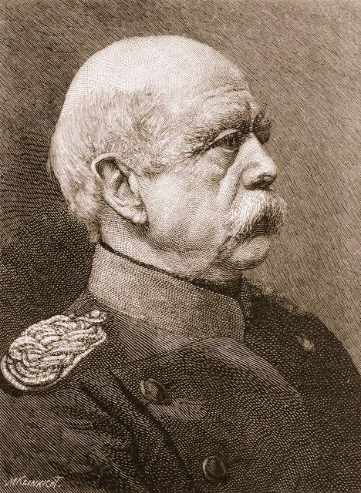
Otto von Bismarck

Slide 30
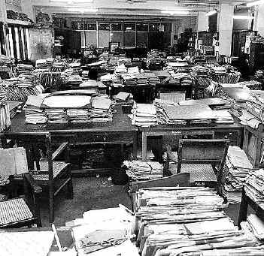
2. Bureaucratic fiat via federal register

Slide 31

3. Quasi-judicial ruling through government agencies such as the Food and Drug Administration

Slide 32

4. Ruling by quasi-government agencies such as the Joint Commission for Accreditation of Healthcare Organizations

Slide 33
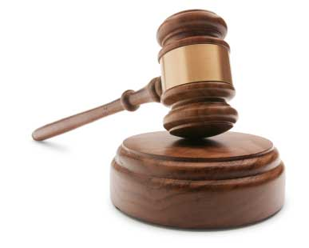
5. The General American Legal Process

Slide 34
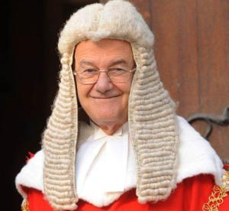
No more Inns of Court

Slide 35
A Different American View
A)Democratization of the Bar/Massive expansion of the tort system
Jury trials (7th Amendment 1791)
Juries extended to non-property owners
Popularly elected judges
Less restrictive entrance to the Bar
Standard of care 1846
Wide malpractice litigation advertisement
Splitting malpractice remedies with plaintiffs

Slide 36

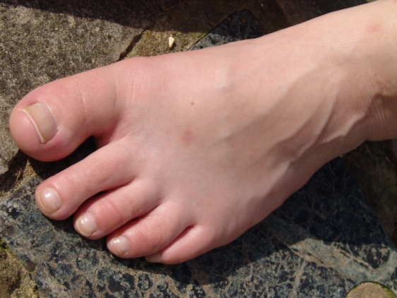
B) Results
Decrease in property rights
Increase in contractual duty, real or implied
Increase in wergild
=

Slide 37
Amendment 7 - Trial by Jury in Civil Cases
In Suits at common law, where the value in controversy shall exceed twenty dollars, the right of trial by jury shall be preserved, and no fact tried by a jury, shall be otherwise re-examined in any Court of the United States, than according to the rules of the common law.

Slide 38
But Still A Central Philosophical Dispute on the Role of Government

Slide 39
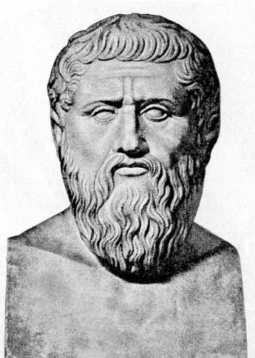
Plato’s Republic.
Oligarchy: A goverment resting on evaluation of property, in which the rich have power, and the poor man is deprived of it.
Democracy is an agreeably anarchic form of society, with plenty of variety, which treats all men as equal, whether they are equal or not.
Democracy passes into despotism.
The people have always some champion whom they set over them and nurse into greatness.... This and no other is the root from which a tyrant springs; when he first appears he is a protector.“
At first, in the early days of his power, [the tyrant] is full of smiles . . . [but later] he is always stirring up some war or other, in order that the people may require a leader.

Slide 40
Different but Similar
The will of the
People
The will of
God
Democratic Imperative
Divine Right of Kings
Lord Acton: “Power tends to corrupt, and absolute power corrupts absolutely.”
Kingship is quite corruptible

Slide 41
Great duality stills exists in the role of the government in an individual’s life
The Leviathan by Thomas Hobbes 1651
The Pilgrim's Progress from This World to That Which Is to Come by John Bunyan 1678

Slide 42
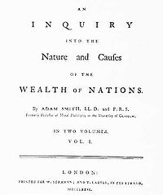
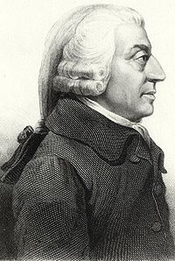

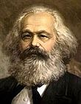
Two Opposing Ideologies
The Wealth of Nations, 1776, By Adam Smith
“The invisible hand”
Das Kapital, 1867, by Karl Marx
“The labor theory of value”

Slide 43
Two Opposing Concepts
The government as the guarantor of natural rights
The government as the transgressor of natural rights
2010 Patient Protection and Affordable Care Act
1776 Declaration of Independence

Slide 44
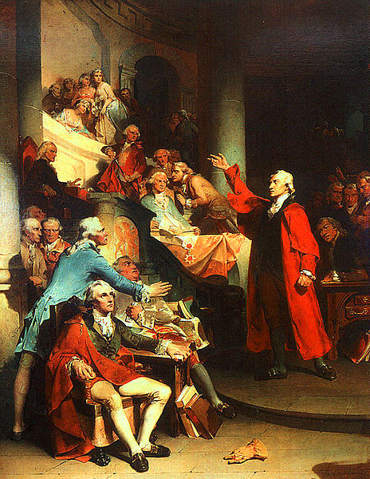
The Government – The Enemy of Natural Rights
"Tarquin and Caesar had each his Brutus, Charles the First his Cromwell, and George the Third [here he was interrupted by cries of "Treason"] and George the Third may profit by their example! If this be treason, make the most of it.“ - Patrick Henry 1765.

Slide 45
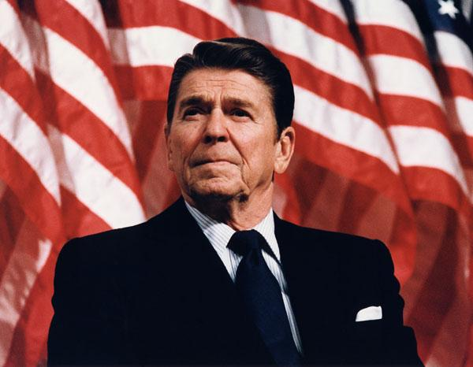
I don't believe in a government that protects us from ourselves.
President Ronald Reagan 1975

Slide 46
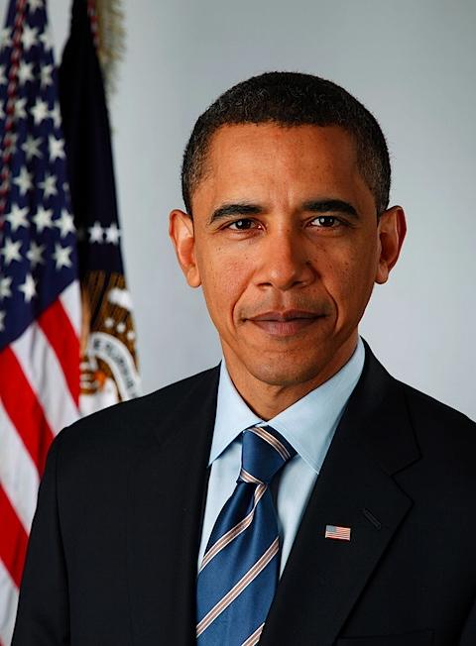
The Government – The Enabler of Natural Rights
“If the people cannot trust their government to do the job for which it exists - to protect them and to promote their common welfare - all else is lost.”
President Barack Obama 2006

Slide 47
The Pros of the Democratic Moral Imperative
Promotes social stability and at best generalized happiness
Allows meritorious individuals a chance at a useful life
Comports with substantial ethical and religious ideals
Is a useful methodology to promote population mobilization toward some great national goal

Slide 48
But if the Evolutionary path is fully applied
Monarchy
Republic
Democracy
← Checks and Balances
Democratic Moral Imperative

Slide 49
The Journey Toward the Moral Democratic Imperative
Limited electorate and free capitalist system
Unlimited electorate with diminished property rights
Government redistributing wealth for political support
Government borrows from future revenues and places restrictions on the capitalist system not immediately evident
As burdens increase the capitalist system is unable to provide sufficient revenue to the government and society collapses

Slide 50
Some Examples of the limitations of the Democratic Moral Imperative

Slide 51
The 2008 US financial crisis caused by the government granting low income people access to otherwise unaffordable home mortgages
The 2009 European debt crisis caused by the government extending social benefit to breaking point.
The rising prosperity on the Chinese mainland with the institution of free economy
The fall of the Soviet Union →

Slide 52
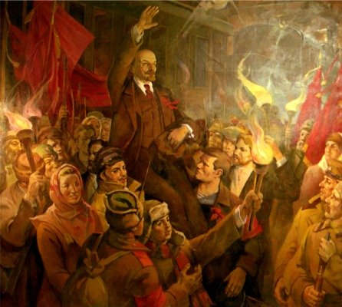
CONSTITUTION OF THE UNION OF SOVIET SOCIALIST REPUBLICS
Article 42. Citizens of the USSR have the right to health protection. This right is ensured by free, qualified medical care provided by state health institutions; by extension of the network of therapeutic and health- building institutions; by the development and improvement of safety and hygiene in industry; by carrying out broad prophylactic measures; by measures to improve the environment; by special care for the health of the rising generation, including prohibition of child labour, excluding the work done by children as part of the school curriculum; and by developing research to prevent and reduce the incidence of disease and ensure citizens a long and active life.

Slide 53

The Lesson of Greece

Slide 54
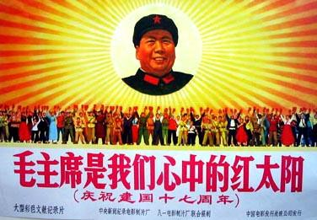
Chairman Mao - The State Sun King - The Destroyer of Landlords Bestowing Grace Upon the Masses

Slide 55
Pursuant to the democratic moral imperative the government has mandated that healthcare is a national right to be obtainable at reasonable cost under strict government regulation

Slide 56
What does this mean for the physician? Government policy enriched physicians but marginalized them

Slide 57
Evolution of US healthcare system
1776 the writ of the Royal College of Surgeons and Royal College of Physicians extinguished in the United States.
It becomes extremely easy to practice medicine on the frontier and rural areas with very sketchy training
1846 ether anesthesia introduced at Massachusetts General Hospital
1876 Lord Lister pioneers OR sterility
1900 Johns Hopkins Hospital pioneers a system of modern physician instructions
1910 the Flexner Report
1942 KP introduced a modern concept of health insurance
1955 Hill-Burden Hospital Act
1965 President Johnson introduced Medicare-Medicaid
1980 DRGs instituted
1980s Obligatory emergency and transfer regulations instituted
1990s The Joint Commission grows mighty
2010 Patient Protection and Affordable Care Act passed.

Slide 58
Physician Practice changes over the last 50 years
Few MDs
Many MDs
No IMG
Many IMG
Low Income
High Income
Low Expenses
High Expenses
Mostly Family Practice
More Specialization
Direct Patient-Doctor Relationship
Patient-Doctor-Insurance Triangle
More Freedom in Decision Making
More Regulations and Restrictions
in Decision Making
Much Less Malpractice Litigation
Malpractice Litigation Crisis
Few Female Physicians
More Female Physicians

Slide 59
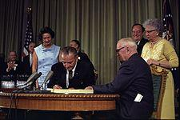
Lyndon Johnson signing the Social Security Act 1965
Before 1951
Family Physician
Physician-patient covenant
Fee-for-service
Christian ethics
Charity
Church attendance
Strong medical guild
Relative less regulatory organs
2011
Physician-specialist
Physician-patient –insurance triangle
3rd party payor
Business ethics
Charity forbidden
Less church attendance
Less powerful medical gild
More regulatory organs

Slide 60
Differences 1951-2011
Ability of physicians to dramatically improve the health of their patients
Along with this, major increase in physician duty to make no mistakes in a far more complicated healthcare system
Major increase in patient expectations of healthcare salvation and corresponding decrease in the solace of religious comfort
A new physician responsibility to adjudicate secondary gain and patient compensation aspirations
Decreased patient responsibility in regard to personal health
The government as the benefactor and insurer of patient healthcare
Destruction of the ancient idea of physician skills as a propriety right
Transformation of the physician-hospital relationship from one in which the physician lodges the patient in the facility to one where the physician is a hospital employee and subject to the hospital administration logest

Slide 61

More Money for Physicians
Health insurance became widespread and tax deductible in a time of increasing marginal tax rates; thus it became in everyone’s interest to have health insurance.
Huge numbers of patients came to physicians paid for by the government.
The physician billed fee for service and procedures.
As a result, physician income rocketed up.
The government increased restraints on physician by state licensing and certification requirements at the hands of professional gilds.
Thus, the priestly role of physician was diminished by the absence of ability to grant charity, the fear of malpractice litigation, and the change in culture toward profit mentality as witness by a decline in church membership, etc.
There was also a decrease in physician property rights as required to see all patient in hospital setting with independent bargaining fairly impossible.

Slide 62
Physician control mechanisms 1951
Ethics
In small town America, aspiration for high physician reputation
Medical society approval

Slide 63
Physician control mechanisms 2011
Malpractice litigation
Restricted hospital staff privileges
Acceptance into insurance arrangements
Adherence to Medicare and Medicaid regulations
Maintenance of medical license by attending medical meetings
Maintenance of Board certification by retesting

Slide 64
But with this came increased physician practice control and regulation mechanisms
 | Government Medicare, Medicaid, Tricare coverage policies | Private Insurance Coverage Policies | InterQual evidence-based clinical decision support criteria | Joint Commission | State Board and Licensing Criteria | TORT Law | Professional Societies | FDA
Pretreatment | √ | √ |  |  | √ |  |  | √
Posttreatment |  |  | √ | √ | √ | √ | √ | √
Because of the national financial healthcare crisis coupled with improved electronic data collection, such regulation is likely to increase in the future

Slide 65
Marginalization

Slide 66
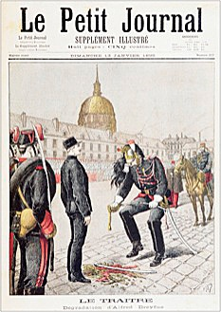
Physician Demotion
Alfred Dreyfus falsely accused of treason and publicly cashiered 1895

Slide 67

The Appearance of the “Healthcare Provider” to the Detriment of the Physician-Patient Covenant

Slide 68
Resulting Physician Shortfalls So the traditional paradigm of an absolute moral commitment to an individual’s patient’s welfare is sustained by rigorously screening with whom one develops a doctor-patient relationship
Avoiding non-insurance patients.
Avoiding subspecialty and geographic areas where compensation is less.
Avoiding emergency room coverage
Care and procedures affected by coding concerns
Testifying against fellow physicians in meritless malpractice cases
Failing to demand high quality research
Avoiding the political process
Not responding to pointless government and insurance ukases

Slide 69
Crisis Chronology
↑ Healthcare Beneficiaries
↑ Physician Compensation
↑ Physician Control Mechanisms
Healthcare Crisis
Healthcare Inefficiency
Physician Marginalization

Slide 70
An additional problem Data difficulties in physicians efforts toward treatment efficiency and resource stewardship

Slide 71
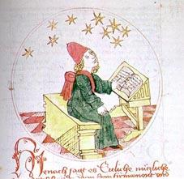
Astrologer diagnosing and prognosticating medical issues by studying the position of the stars (German manuscript, 1464)

Slide 72
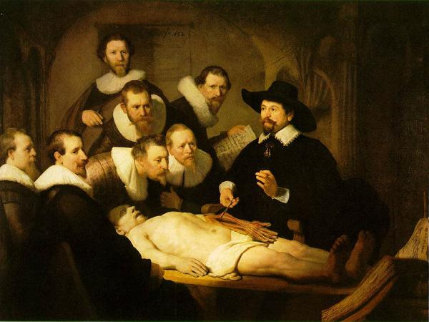
Rembrandt “The Anatomy Lesson of Doctor Tulp” (1632)

Slide 73
Evidence-Based Medicine (EBM)
is defined as “conscientious, explicit, and judicious use of current best evidence in making decisions about the care of individual patients.”
Sackett et al. 1997

Slide 74
Clinical Practice Guidelines (CPGs)
are defined according to the Institute of Medicine (1990) as "systematically developed statements to assist practitioner and patient decisions about appropriate health care for specific clinical circumstances.“*
In French - Lignes Directrices Cliniques.
* Field, M., and K. Lohr, eds. 1990. Clinical Practice Guidelines: Directions for a New
Program 8. Washington, DC: Institute of Medicine.

Slide 75
Clinical Practice Guidelines (CPG) Development
Evidence-
based Medicine
Consensus Process
Clinical Practice Guidelines

Slide 76
The scales are tipping toward EBM
Consensus
Evidence-based Medicine
Evidence-based Medicine
Consensus
Evidence-based Medicine
Consensus
Evidence-based Medicine

Slide 77
US Preventive Services Task Force Classification of Clinical Evidence
Level I: Evidence obtained from at least one properly designed randomized controlled trial (RCT).
Level II-1: Evidence obtained from well-designed controlled trials without randomization.
Level II-2: Evidence obtained from well-designed cohort or case-control analytic studies, preferably from more than one center or research group.
Level II-3: Evidence obtained from multiple time series with or without the intervention. Dramatic results in uncontrolled trials might also be regarded as this type of evidence.
Level III: Opinions of respected authorities, based on clinical experience, descriptive studies, or reports of expert committees.

Slide 78
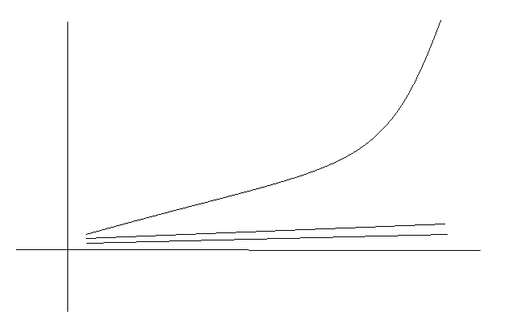
Healthcare
Clinical Research
Medical Education
Very little money was spent on high-grade research and on medical education and training compared with general medical expenditures. In the absence of high-grade clinical studies, the physician was able to practice at his discretion. Moreover, no shared gains were possible because of Stark regulations.

Slide 79
Examples of shortfalls in neurosurgical and orthopedic literature that 3rd party payers use to control patient care

Slide 80
Neurosurgical Literature

Slide 81

Neurosurgical Literature 1996-2010

Slide 82
Blinded Neurosurgical RCTs 1996–2010

Slide 83

Number of Neurosurgical RCTs with Cost Element 1996–2010

Slide 84
Orthopaedic Literature

Slide 85

The number of blinded RCTs with cost analysis among orthopedic RCTs and the number of practice guidelines papers and practice guidelines with cost. Total number of orthopedic literature from 1996 to 2010 is 73948.

Slide 86
The increase in the number of orthopedic RCTs, non-RCTs, blinded RCTS, RCTS with cost component, blinded RCTs with cost component, and practice guidelines from 1996 to 2010.

Slide 87
Spine fusion practice guidelines as an example

Slide 88
Aggregate Hospital Charges for Neurosurgical Procedures in the United States

Slide 89
The increase in the number of spine fusion RCTs, non-RCTs, blinded RCTS, RCTS with cost component, blinded RCTs with cost component, and practice guidelines from 1996 to 2010.

Slide 90
42 Recommendations: Method of Analysis
 | Source | Year | Level I | Level II | Level III
Anterior cervical discectomy and ACD with fusion (ACDF) are associated with longer term (12 months) improvement in certain motor functions compared to PT. However, comparable clinical improvements with PT or cervical immobilization therapy are also present in these clinical modalities | AANS/CNS | 2009 | 1 | 0 | 0
The addition of pedicle screw fixation to PLF increases fusion success rates when assessed based on plain x-ray films with dynamic imaging. | AANS/CNS | 2005 | 1 | 1 | 1
The use of lumbar fusion as a treatment standard for carefully selected patients with low-back pain intractable to the best medical management. | AANS/CNS | 2005 | 1 | 0 | 0
Association between clinical outcome and pseudarthrosis with variable incidence of symptomatic and asymptomatic pseudarthroses | AANS/CNS | 2009 | 0 | 0 | 1
Revision of a symptomatic pseudarthrosis may be considered because arthrodesis is associated with improved clinical outcome | AANS/CNS | 2009 | 0 | 0 | 1
Posterior approaches may be associated with higher fusion rates following repair of an anterior pseudarthrosis | AANS/CNS | 2009 | 0 | 0 | 1
Pseudarthrosis is best assessed through the absence of motion detected between the spinous processes on dynamic radiographs | AANS/CNS | 2009 | 0 | 1 | 0
The measurement of interspinous distance on dynamic radiographs of >or= 2 mm is a more reliable indicator for pseudarthrosis than angular motion of 2 degrees based on Cobb angle measurements | AANS/CNS | 2009 | 0 | 1 | 0
The combination of interspinous distance measurements and identification of bone trabeculation is unreliable when performed by the treating surgeon | AANS/CNS | 2009 | 0 | 1 | 0
Identification of bone trabeculation on static radiographs should be considered a less reliable indicator of cervical arthrodesis than dynamic films | AANS/CNS | 2009 | 0 | 0 | 1
Autograft bone harvested from the iliac crest, allograft bone from either cadaveric iliac crest or fibula, or titanium cages and rectangular fusion devices, with or without the use of autologous graft or substitute, have been successful in creating arthrodesis after 1- or 2-level anterior cervical discectomy with fusion | AANS/CNS | 2009 | 0 | 1 | 0
Alternatives to autograft, allograft, or titanium cages include polyetheretherketone cages and carbon fiber cages | AANS/CNS | 2009 | 0 | 0 | 1

Slide 91
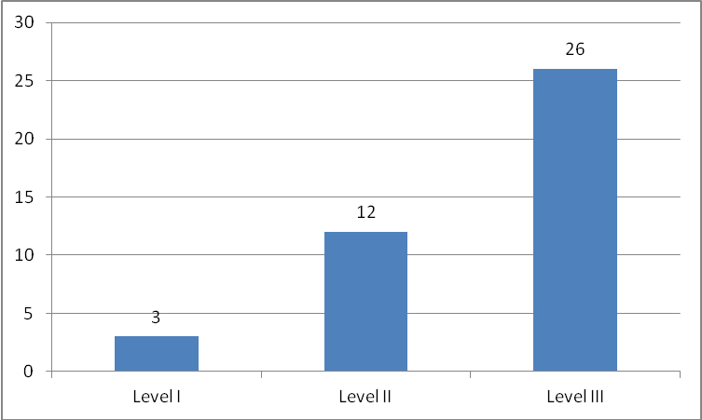
Levels of evidence for recommendations related to Spine Fusion

Slide 92
Topic of Practice Guidelines Papers related to Spine Fusion

Slide 93
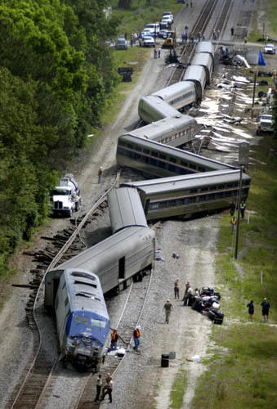
The Train Wreck!
The government is attempting to diminish healthcare expenses while the all indicators point to more money needed for the healthcare system, especially for clinical research and medical education.

Slide 94
Thus
Democratic moral imperative→←Government intervention in the life of citizens
Democracy→←Republic
Equality→←Efficiency
Business→←Charity
One man one vote→←Only taxpayers vote
Equal healthcare for all→←Two-tiered healthcare system
High duty of the possessor→←Low duty of the possessor
High property rights→←Low property rights
High weregild →←Low weregild
Low healthcare consumption→←Overutilization

Slide 95
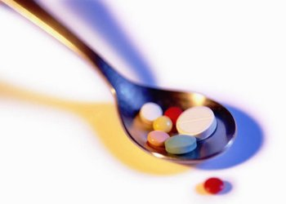
A Potential Remedy – Patient Protection and Affordable Care Act 2010

Slide 96
Health Care Reform Bill Summary
Cost:
$940 billion over ten years.
Deficit:
Would reduce the deficit by $143 billion over the first ten years. That is an updated CBO estimate. Their first preliminary estimate said it would reduce the deficit by $130 billion over ten years. Would reduce the deficit by $1.2 trillion dollars in the second ten
Coverage:
Would expand coverage to 32 million Americans who are currently uninsured.
Health Insurance Exchanges:
The uninsured and self-employed would be able to purchase insurance through state-based exchanges with subsidies available to individuals and families with income between the 133 percent and 400 percent of poverty level.
Separate exchanges would be created for small businesses to purchase coverage -- effective 2014.
Funding available to states to establish exchanges within one year of enactment and until January 1, 2015.
Subsidies:
Individuals and families who make between 100 percent - 400 percent of the Federal Poverty Level (FPL) and want to purchase their own health insurance on an exchange are eligible for subsidies. They cannot be eligible for Medicare, Medicaid and cannot be covered by an employer. Eligible buyers receive premium credits and there is a cap for how much they have to contribute to their premiums on a sliding scale.
Federal Poverty Level for family of four is $22,050
Paying for the Plan:
Medicare Payroll tax on investment income -- Starting in 2012, the Medicare Payroll Tax will be expanded to include unearned income. That will be a 3.8 percent tax on investment income for families making more than $250,000 per year ($200,000 for individuals).
Excise Tax -- Beginning in 2018, insurance companies will pay a 40 percent excise tax on so-called "Cadillac" high-end insurance plans worth over $27,500 for families ($10,200 for individuals). Dental and vision plans are exempt and will not be counted in the total cost of a family's plan.
Tanning Tax -- 10 percent excise tax on indoor tanning services.

Slide 97
Medicare:
Closes the Medicare prescription drug "donut hole" by 2020. Seniors who hit the donut hole by 2010 will receive a $250 rebate.
Beginning in 2011, seniors in the gap will receive a 50 percent discount on brand name drugs. The bill also includes $500 billion in Medicare cuts over the next decade.
Medicaid:
Expands Medicaid to include 133 percent of federal poverty level which is $29,327 for a family of four.
Requires states to expand Medicaid to include childless adults starting in 2014.
Federal Government pays 100 percent of costs for covering newly eligible individuals through 2016.
Illegal immigrants are not eligible for Medicaid.
Insurance Reforms:
Six months after enactment, insurance companies could no longer deny children coverage based on a preexisting condition.
Starting in 2014, insurance companies cannot deny coverage to anyone with preexisting conditions.
Insurance companies must allow children to stay on their parent's insurance plans until age 26th.

Slide 98
Abortion:
The bill segregates private insurance premium funds from taxpayer funds. Individuals would have to pay for abortion coverage by making two separate payments, private funds would have to be kept in a separate account from federal and taxpayer funds.
No health care plan would be required to offer abortion coverage. States could pass legislation choosing to opt out of offering abortion coverage through the exchange.
**Separately, anti-abortion Democrats worked out language with the White House on an executive order that would state that no federal funds can be used to pay for abortions except in the case of rape, incest or health of the mother.
Individual Mandate:
In 2014, everyone must purchase health insurance or face a $695 annual fine. There are some exceptions for low-income people.
Employer Mandate:
Technically, there is no employer mandate. Employers with more than 50 employees must provide health insurance or pay a fine of $2000 per worker each year if any worker receives federal subsidies to purchase health insurance. Fines applied to entire number of employees minus some allowances.
Immigration:
Illegal immigrants will not be allowed to buy health insurance in the exchanges -- even if they pay completely with their own money.

Slide 99
Problems with the Enacted Legislation
Diminishes the free marketplace in health insurance requiring high premiums to be passed on to healthy individuals
Mandates penalties for not having health insurance - probably unconstitutional
Expands Medicaid placing substantial burdens on the states
Drastically increases government regulatory review of the healthcare system
Sets up a commission of 15 that will establish guidelines and cost procedures independent of any oversight which will allow government control of the healthcare system
This legislation does some good things too: Some efforts at more even distribution of healthcare resources; more money for medical education, and mechanism for high quality medical research.
After full implementation of this legislation, nearly 85% of citizens will be under direct government healthcare regulation; the remaining 15% will be in very high-deductable plans and workers’ compensation arrangements. Thus, a top-down bureaucracy will exacerbate the present dysfunction of the American healthcare system by de-incentivizing physicians diminishing further their social covenant with their patients and promoting major societal stress. Additionally, from a broader point of view, the aggregation of government power and its ability to deliver economic and emotional supports to the dependent classes point the way, as Plato suggested, to despotism

Slide 100
Begs the question?
Two-tiered healthcare?
or
Rationing of healthcare?

Slide 101

Another solution for the problem

Slide 102
Two Paradigms
The old paradigm: The physician is morally obligated to expend every possible healthcare resource in the care of his patients
An additional new paradigm: The physician is morally obligated to exercise stewardship of healthcare resources in the care of his patients
← Micro
← Macro

Slide 103

Under the umbrella of enhanced physician responsibility the following improvements in the American healthcare system could hypothetically be instituted:

Slide 104
Suggestions
A fexible balanced system
Checks and Balances
End Inefficient Government Regulation and unfunded mandates - Physician empowered to stop wasteful treatment without penalty
Patient Responsibility
Better Clinical Evidence: Substantial attention to clinical research with measured development of clinical practice guidelines
Appropriate physician control mechanism
The Priestly Physician
Preservation of the Doctor-Patient Covenant
Physician collaboration to improve the system

Slide 105
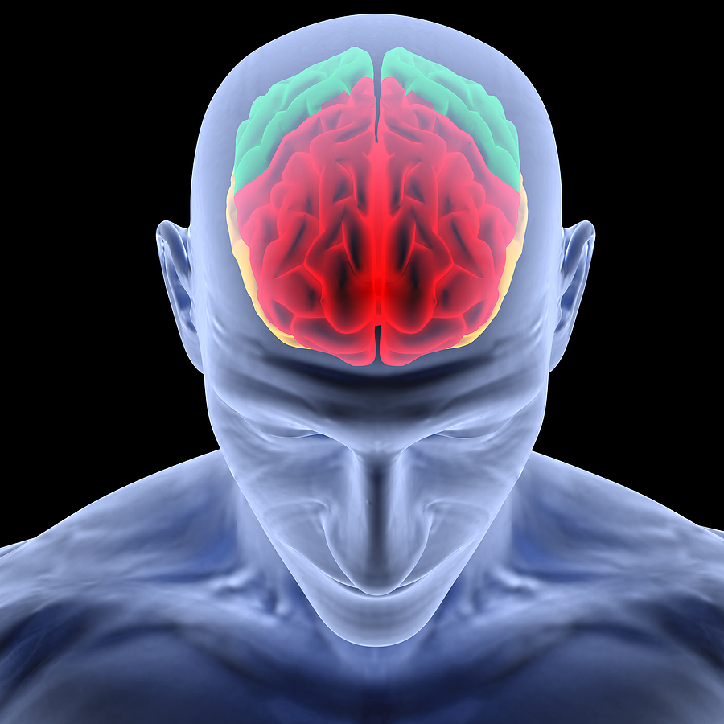
1. No healthcare system should be under rigid centralized control as absolutes invariably prove ineffectual
Neurochemistry and neuronal structure arguably ensure that anger, lust and greed (as well as possibly altruism) remain permanently embedded in every human. By extrapolation, in broader political and social institutions, including those that govern healthcare, utopian worldviews and political system that fail to consider humanity’s true and ambivalent nature chance great unintended evil - a truism well recognized by the framers of the constitution

Slide 106
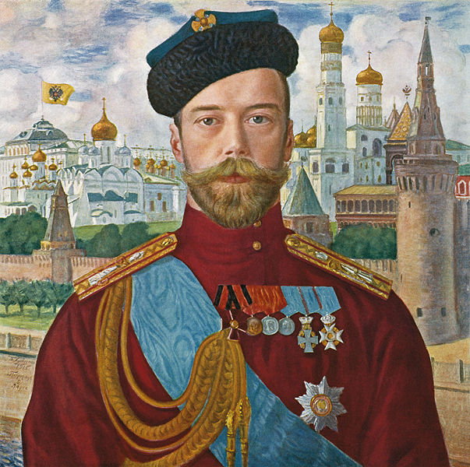
2. Checks and Balances
No more automatic acceptance of government ukases
Tsar Nicholas II

Slide 107
3. End Inefficient Government Regulation and unfunded mandates
Joint Commission constantly puts additional regulations on hospitals which consequently pass these burdens to physicians
No effective mechanisms exist to transfer back to a primary care facility a patient which the government requires to be transferred to a tertiary care center
Numerous regulations are in place in the healthcare system which contravene efficient care
Medicare patients require to stay in hospital needless amounts of time in the presence of low-grade temperature
Regulations for pain control result in substantial prolonging of hospital stay

Slide 108
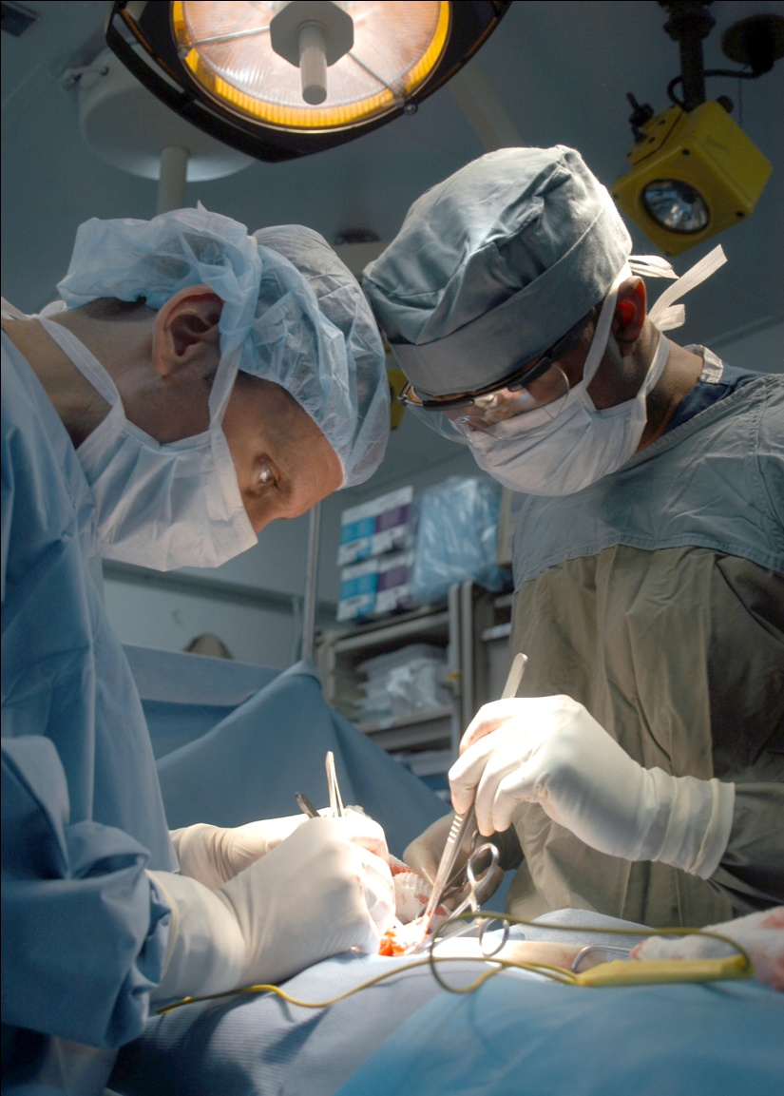
3. An Example
Requirements for nonhostile workplace in stressful areas such as the OR diminish physicians’ ability to effectively look after the best interest of their patients.

Slide 109
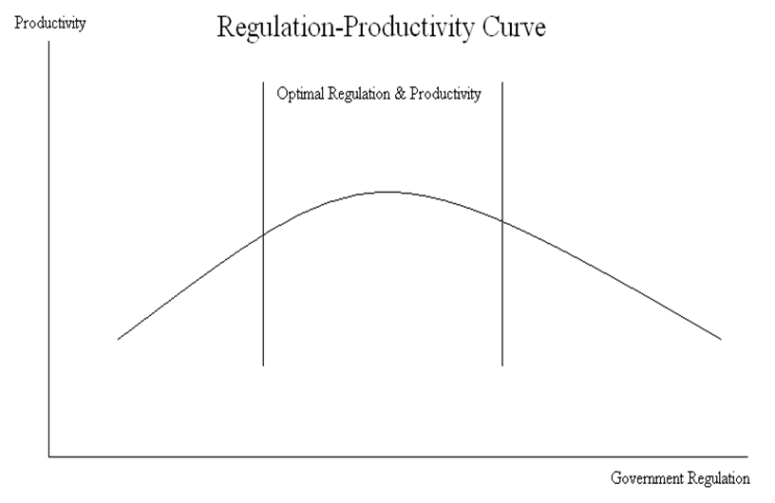
3.

Slide 110
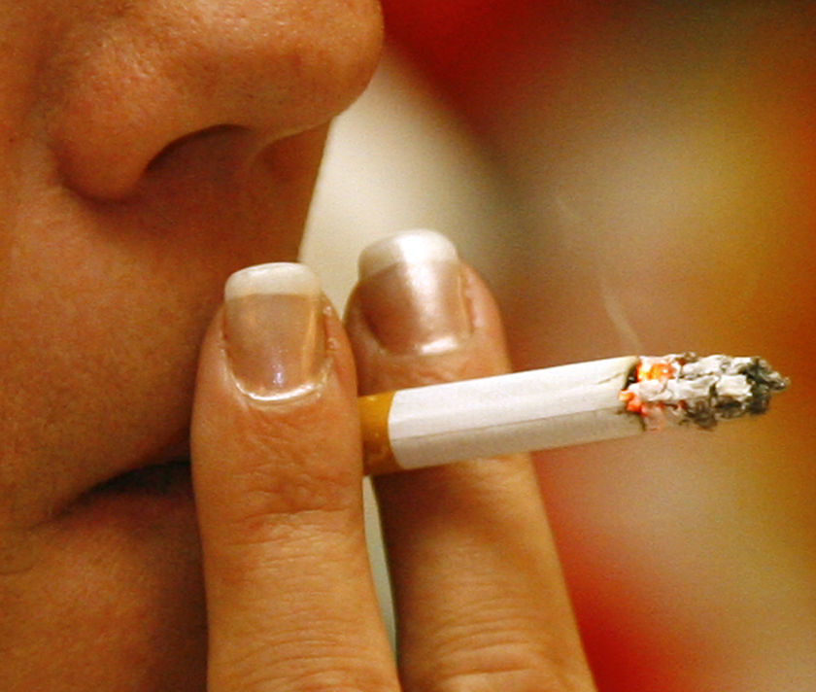
4. Patient Responsibility
Compliance with physician orders
Avoiding high risk behaviors, i.e. smoking, illicit drugs, violence, reckless driving …
Literacy in personal healthcare issues
No abuse of the healthcare system for secondary gain, i.e. opioids, disability payments …
Delay retirement age

Slide 111
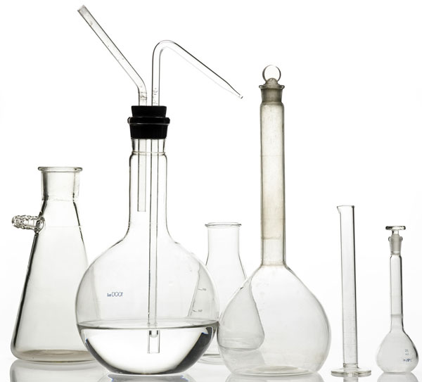
5. Substantial attention to clinical research with measured development of clinical practice guidelines

Slide 112
5. “Value in Healthcare”
Value = Healthcare outcomes/Costs of delivering the outcomes
Our addendum to this formula is that both outcome and cost variables should be generalized and long-term
Porter ME. What is value in health care? N Engl J Med. 2010 Dec 23;363(26):2477-81.

Slide 113
5. Better Clinical Evidence Interlocking Concepts
Clinical Decision,
Insurance Arrangements,
Government Regulations,
Tort Law
Practice Guidelines & Standards of Care
Clinical Evidence

Slide 114
5. IOM Standards for Developing Trustworthy CPGs March 2011
Establishing transparency
Management of conflict of interest (COI)*
Guideline development group composition
Clinical practice guideline–systematic review intersection
Establishing evidence foundations for and rating strength of recommendations
Articulation of recommendations
External review*
Updating

Slide 115
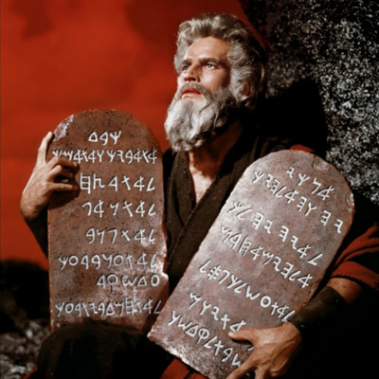
5. Suggested Additions
Cost consideration
Long-term follow-up and cost-benefit analysis
The advantages and disadvantages of biomarkers versus actual patient outcome should be strongly considered
A provision to allow new procedures that contravene practice guidelines
A provision to measure patient compliance with the prescribed treatment
A mechanism for funding high-grade studies on new technologies for which great amount of societal benefit can be achieved.
CONSORT criteria should be used by the NGC to better grade quality of research
An appeal mechanism

Slide 116
5.
These IOM criteria should be applied to any organizations attempting to regulate healthcare delivery especially the Committee of 15 mandated under The Patient Protection and Affordable Care Act 2010

Slide 117

6. Appropriate physician control mechanism:
High ethical standards putting the patient first
Compensation arrangements unaffected by clinical decisions
Strong doctor-patient relationship
Easy and concise appeal mechanism for decisions that diminish patient care
Greater institution of clinical practice guideline studies
Quick adoption of new clinical insights as discovered by clinical practice guideline studies
Less reliance on the tort system

Slide 118
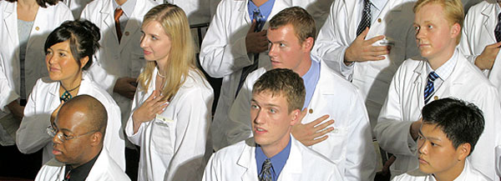
7. The Priestly Physician

Slide 119
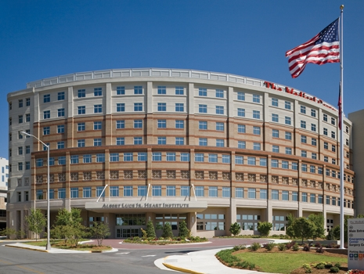

7.
The Medical Center of Central Georgia
Salisbury Cathedral, England

Slide 120
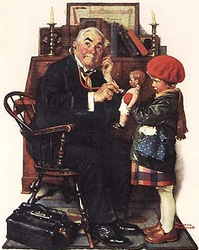
8. Preservation of the Doctor-Patient Covenant
Norman Rockwell 1929

Slide 121

9. Physician collaboration to improve the system

Slide 122
Local collaboration
Medical Center of Central Georgia
Private Physicians
Mercer University School of Medicine

Slide 123
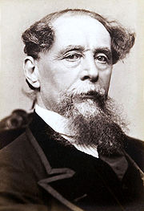
A Remembrance of “a Christmas Carol” by Charles Dickens 1843

Slide 124
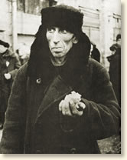
The Bad Dream – Marginalized and Dependent physician

Slide 125
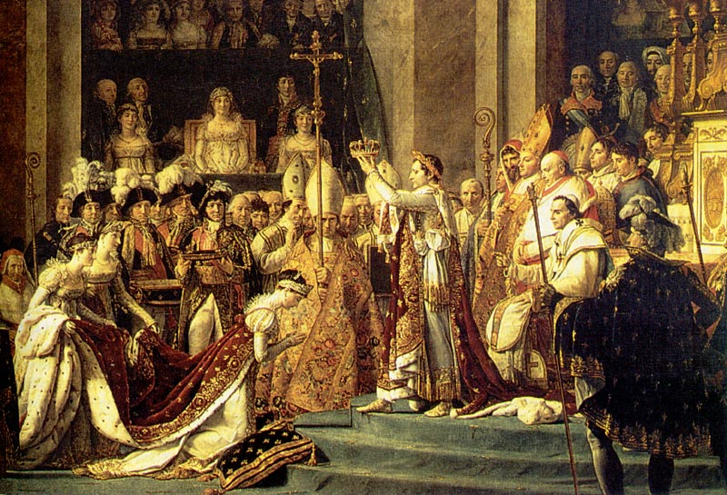
The Good Dream – Physician – The Self-empowered Protector of patient rights

Slide 126
Thank You

