Slide 1
Grand Rounds 2017
Presented Macon, GA by Joe Sam Robinson, Jr., M.D.

Slide 2
HEALTHCARE RESOURCE ALLOCATION IN A TIME OF CRISIS
TIGRAN KHACHATRYAN
JOE SAM ROBINSON M.D.

Slide 3
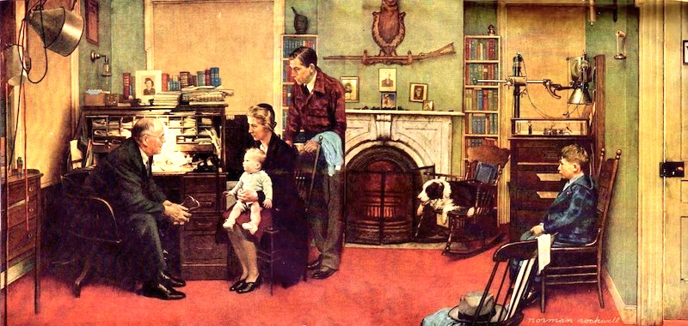
An early 20th century visit to a country doctor

Slide 4
An Earlier Paradigm
DOCTOR
HOSPITAL
PATIENT

Slide 5
However….

Slide 6
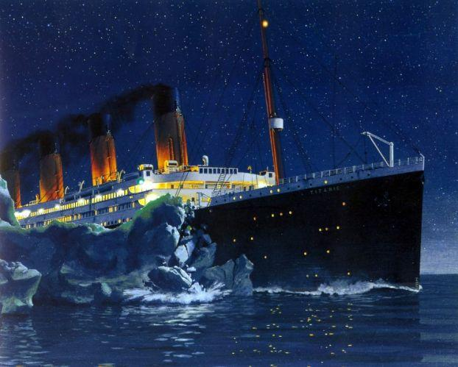
American Healthcare System
Health Expenses
Notes:
http://enjitenjitsemut.files.wordpress.com/2013/10/titanic-hitting-an-ice-burg13.jpg

Slide 7
US healthcare is too expensive for individual responsibility
% population
17% of Americans can afford
treatment of:
SAH
Ischemic Stroke*
Degenerative spine disease*
40%
22,9%
3% of Americans can afford
GBM treatment
17%
3%
wealth
0
$10.000
$100.000
$1 million
$86,3 billion
*these diseases require lifelong ongoing expenses
Notes:
Millionaires - https://www.cnbc.com/2017/06/23/how-many-americans-are-millionaires.html
100K - https://www.quora.com/What-percent-of-Americans-make-more-than-100-000

Slide 8
So, income transference is necessary…

Slide 9
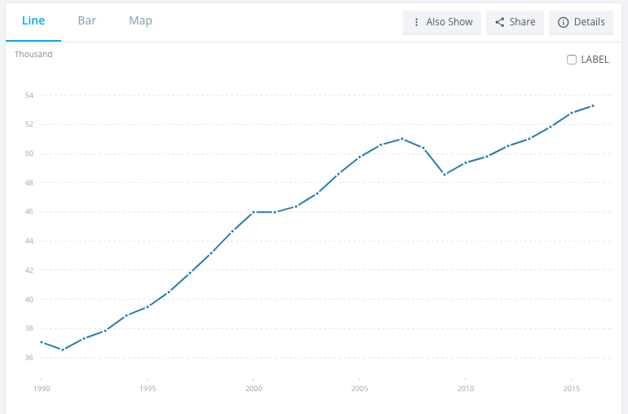
Despite the increase in US GDP per capita (constant 2011 international $)
$53,272
(2014)
$37,062
(1990)

Slide 10
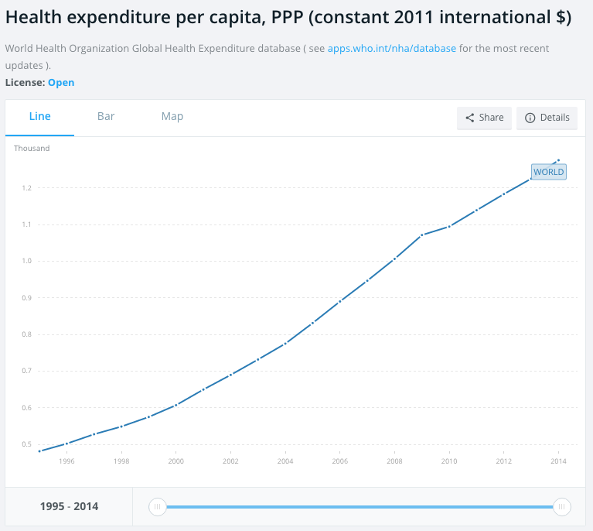
Increase in US health expenditure per capita
$1.275
(2015)
$481
(1995)

Slide 11
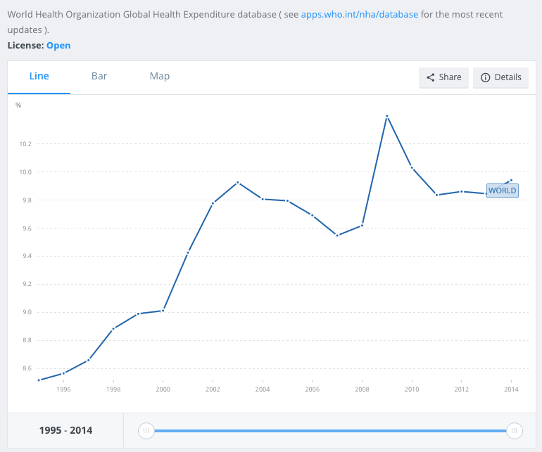
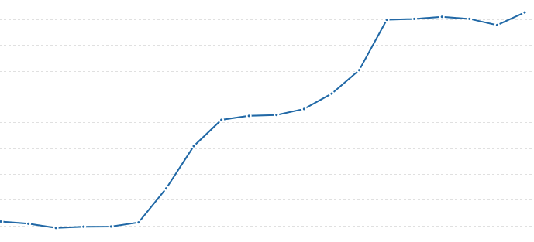
Increase in US health expenditure (% of GDP)
16.9%
(2014)
13%
(1995)

Slide 12
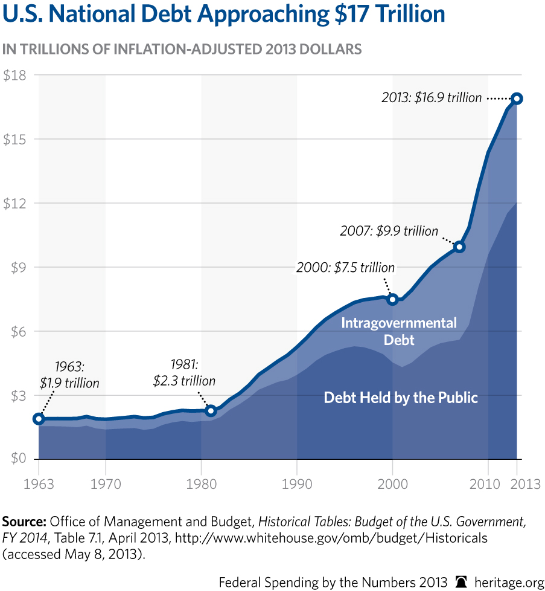

Slide 13
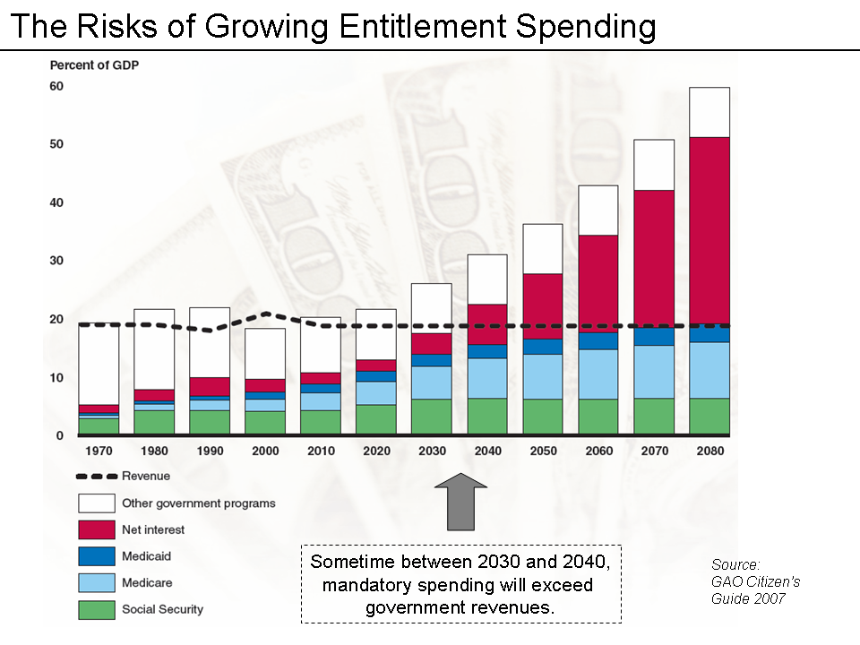

Slide 14
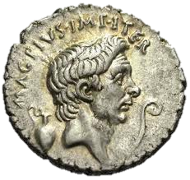
This happened before
Government financial shortfall mandated inflation in ancient Rome
To keep up with the Government expenses, Roman emperors began to debase the currency.
By the time of Claudius II Gothicus the amount of silver in a supposedly 100% silver denarius was only 0.02%.

Slide 15
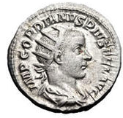
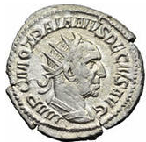
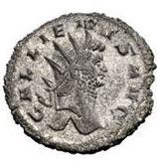
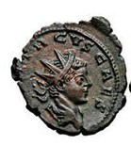
The rapid decline in silver purity of Roman coins
240 CE
40% fineness
250 CE
30% fineness
260 CE
20% fineness
270 CE
<5% fineness
Source: Wikipedia – Roman Currency
Notes:
https://en.wikipedia.org/wiki/Roman_currency

Slide 16
So…

Slide 17
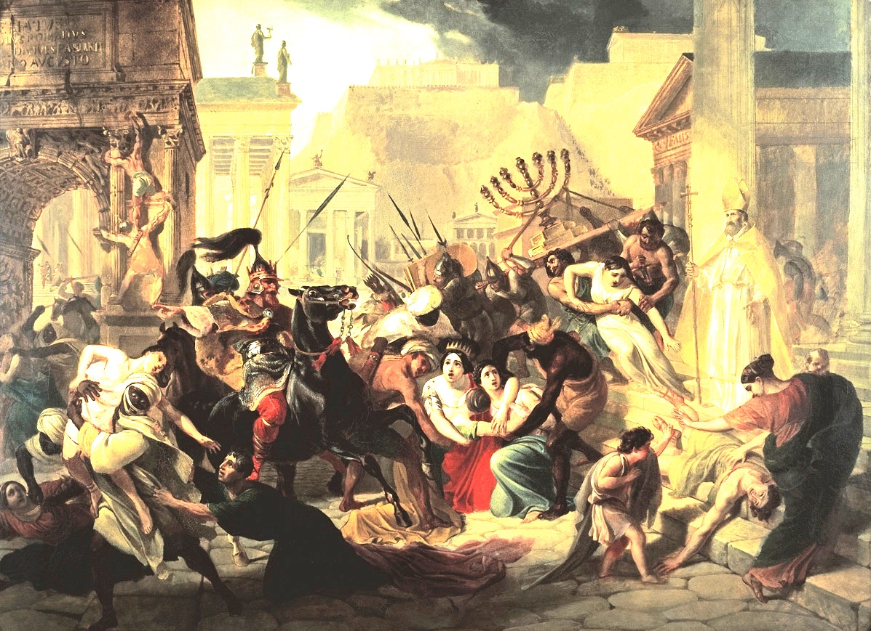
Visigoths Destroy Rome, 410 A.D.

Slide 18
How to decrease the healthcare expenses?

Slide 19

UK National Health Service

Slide 20
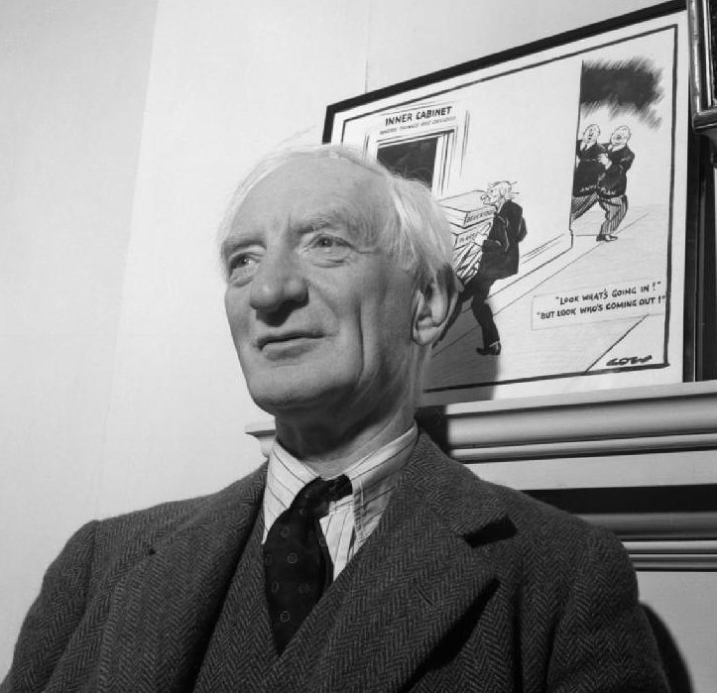
Lord Beveridge in 1943

Slide 21
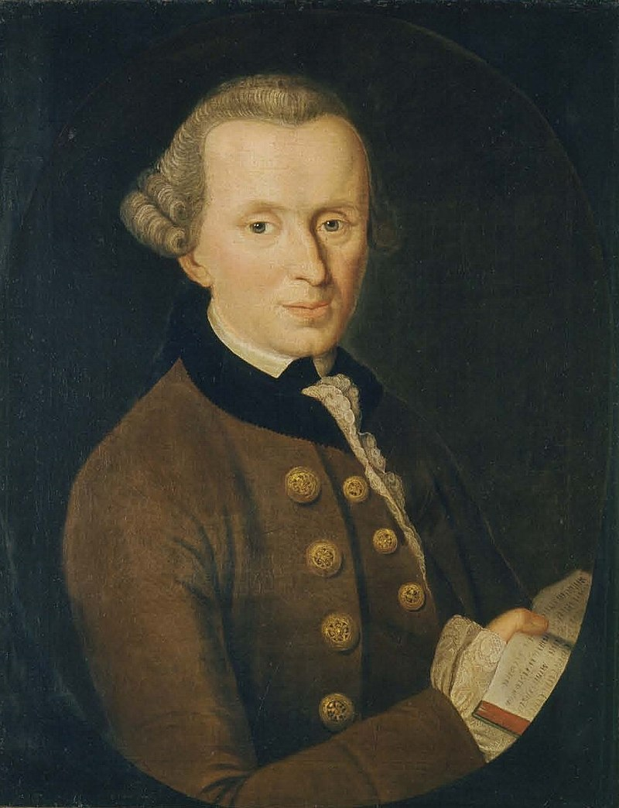
Immanuel Kant
1724-1804

Slide 22
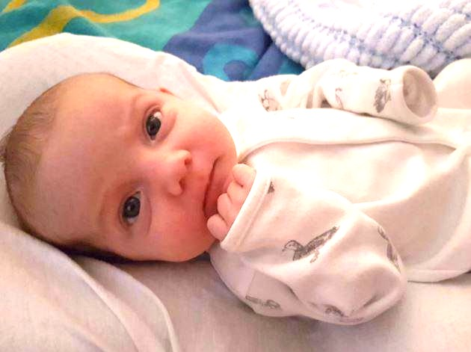
Charlie Gard suffering from MDDS

Slide 23

However, in the United States – the greatest country in the world, all citizens are entitled to -
Everything for everybody no matter what the expense!

Slide 24

No “Death Panels” here
Sarah Palin

Slide 25


So… Clumsy Government and Insurance Regulations

Slide 26

Rather extreme healthcare expenditures are being enforced by legal system, requiring physicians make no mistakes regardless of expense issues.

Slide 27
Georgia Code – Standard of Care
Georgia has a statute which defines the standard of care as follows:
“A person professing to practice surgery or the administering of medicine for compensation must bring to the exercise of his profession a reasonable degree of care and skill. Any injury resulting from a want of such care and skill shall be a tort for which a recovery may be had.”O.C.G.A. section 51-1-27
In other words, the standard of care may sometimes be described as doing what a reasonable or reasonably prudent doctor would do under the circumstances.
Notes:
https://georgiamalpractice.com/malpractice-questions/definition/

Slide 28
NOW
INSURANCE
LAWYERS
?
GOVERNMENT
DOCTOR
HOSPITAL
PATIENT
Attempt to decrease
EXPENCES
Attempt to increase
EXPENCES

Slide 29


Slide 30
Is there another way?
What would happen if we try to do what the UK healthcare system does with Neurosurgical procedures?

Slide 31
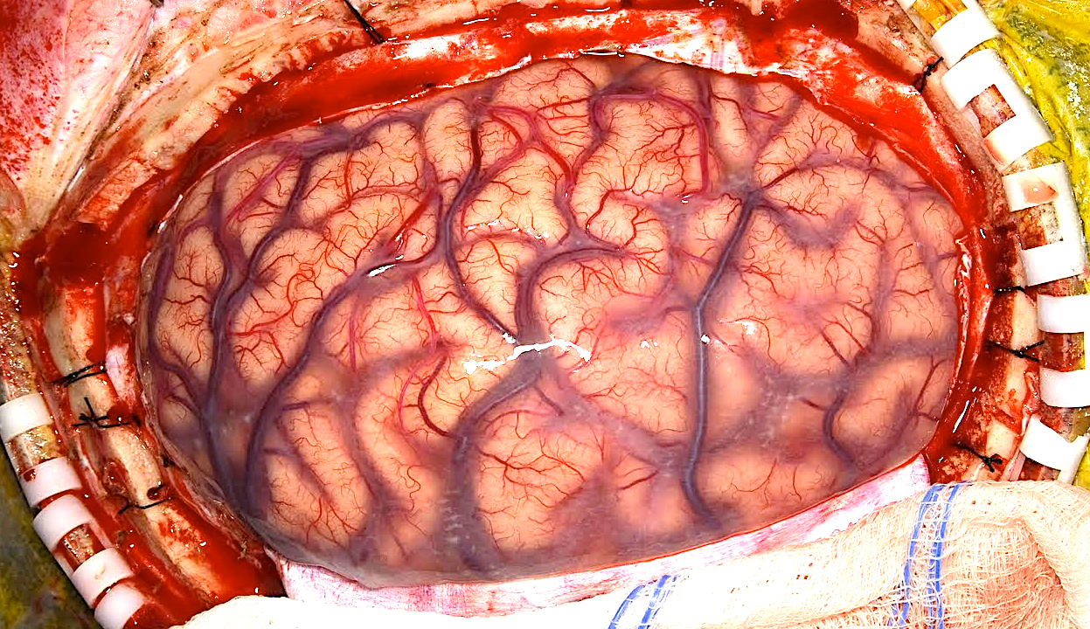
NEUROSURGERY EXPENDITURES
General Comments

Slide 32
Neurosurgery expenditures in the United States
Calculated using Center of Medicare & Medicaid data
Medicare payments to Neurosurgeons as salary in 2014 - $612,417,016
Medicare makes 20% of total insurance expenditures
Thus, total Neurosurgery salaries paid by Insurance – $3,062,085,080
Neurosurgeon’s salary makes 20% of all personnel expenditures
Thus, total personnel expenditure is - $15,310,425,400
Insurance makes 74% of total health expenditures
Thus, total Neurosurgeon Salary in US - $20.6 billion
Salaries make 20% of total Health expenditure
Thus, total Neurosurgery expenditure in US - $103 billion (3% of US health expenditure)
Notes:
https://data.cms.gov/Public-Use-Files/Medicare-Provider-Utilization-and-Payment-Data-Phy/ee7f-sh97

Slide 33
Aggregate hospital charges for neurosurgical procedures in the united states

Slide 34
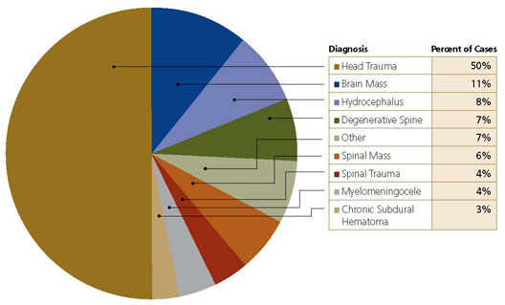
Neurosurgical Procedures in Ethiopia
Notes:
http://www.aans.org/en/AANS%20and%20JNSPG%20Publications/AANS%20Neurosurgeon/AANS%20Neurosurgeon%20Issues/2008/2008%20-%20Issue%203/Neurosurgery%20in%20Ethiopia%20-%20A%20Review%20of%20Current%20Status%20Residency%20Training%20and%20Future%20Directions.aspx?p=1

Slide 35
Neurosurgery expenditures in Armenia
$2.8 million total neurosurgery expenditure in 2015*
*there are substantial direct unregistered payments to doctors
3.101 Neurosurgical procedures in 2015

Slide 36
Now…

Slide 37


Slide 38
A comparative exercise
British National Health Service style
Glioblastoma
Subarachnoid hemorrhage
Ischemic Stroke
Degenerative spine diseases

Slide 39
Severity of the disease
Red Zone: Severe enough to require acute treatment
Cost of Aftercare not commented upon
Cost of acute
treatment
0 10 20 30 40 50 60 70 80
Age
Notes:
GBM - http://cebp.aacrjournals.org/content/23/10/1985
Ischemic Stroke - http://stroke.ahajournals.org/content/32/12/2741
SAH- http://stroke.ahajournals.org/content/31/8/1843
DDD- http://ard.bmj.com/content/73/6/968

Slide 40
Epidemiology
Disease | Incidence | Prevention / early diagnosis | Acuteness/chronicity | Cause
Glioblastoma | 3/100,000 | Not available | Subacute | Unknown
Subarachnoid hemorrhage | 15/100,000 | Not available | Acute | Multifactorial
Ischemic stroke | 246/100,000 | Available | Acute | Multifactorial
Degenerative spine disease | 20,000/100,000 | ?? | Chronic | Multifactorial
Notes:
http://phx.corporate-ir.net/External.File?item=UGFyZW50SUQ9NDg5MjE4fENoaWxkSUQ9NTI1ODg3fFR5cGU9MQ==&t=1

Slide 41
We will look into
Guidelines
Benefit of guidelines
Cost

Slide 42
GUIDELINES

Slide 43
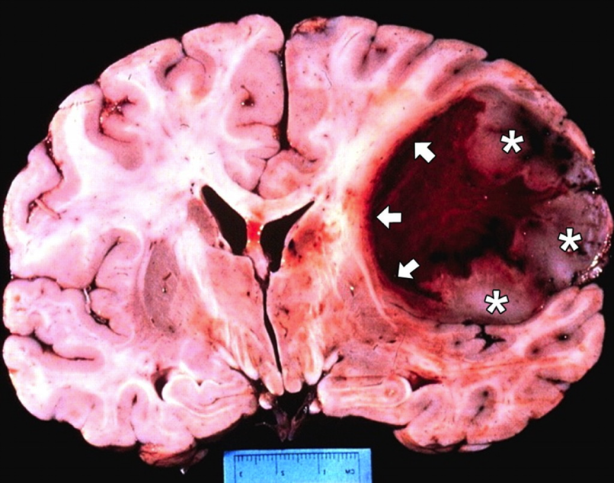
GUIDELINES - Glioblastoma
    Published articles
    Types of published articles
    Clinical Guidelines/ Standard of care
    Main countries publishing guidelines
    Most recent guidelines
    Summary of guidelines
    Guideline limitations

Slide 44
i. Published articles about cerebral gliomas or glioblastomas – 28.577
13.530
Term cerebral
glioma (1863)
Term glioblastoma (1929)

Slide 45
ii. Published articles by type of research
Basic Science Research
2/3
Clinical Articles
1/3

Slide 46
iii. Published articles about cerebral gliomas or glioblastomas – 28.577 and Guidelines
13.530
Term cerebral
glioma (1874)
Term glioblastoma (1929)

Slide 47
iii. Articles related to clinical guidelines for treatment of gliomas or glioblastomas – 40

Slide 48
iv. Most published guidelines for GBM are from
US or Western Europe
 | USA | UK | Switzerland | Germany | Netherlands | Spain | Belgium
2006 | 1
2007 |  | 1 | 1
2008 |  | 1
2009
2010 |  | 1 |  |  |  | 1
2011 | 1
2012 | 5 | 1 |  |  |  |  | 1
2013 | 2
2014 | 9 |  | 1 | 1 | 1
2015 | 7 | 1 | 1
2016 | 3 |  |  | 1 | 1
2017 | 1

Slide 49

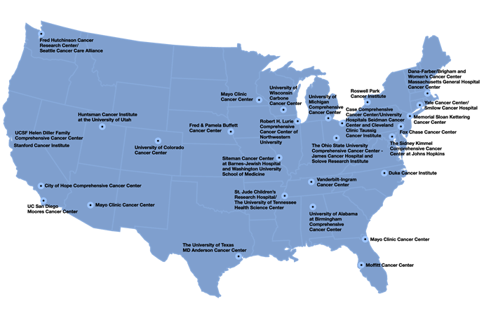
National Comprehensive Cancer Network (NCCN) is an alliance of 27 cancer centers in the United States, most of which are designated by the National Cancer Institute as comprehensive cancer centers.
Notes:
https://en.wikipedia.org/wiki/National_Comprehensive_Cancer_Network#NCCN_Member_Institutions

Slide 50
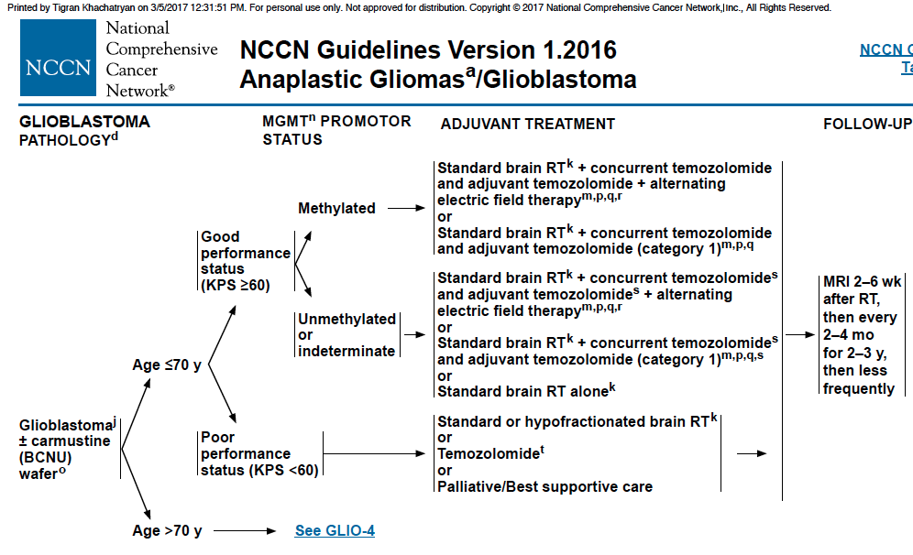
v. GBM Guidelines – Adjuvant Treatment (Age <70)

Slide 51
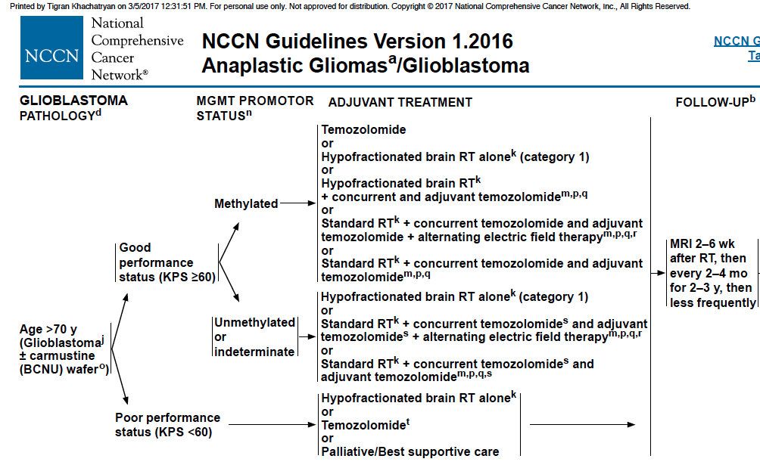
v. GBM Guidelines – Adjuvant Treatment (Age >70)

Slide 52
vi. Summary of published clinical guidelines
Generally addressed issues
Who to treat?
Role of surgery
Role of chemotherapy
Role of radiation
Management of recurrence
No reference to cost!

Slide 53
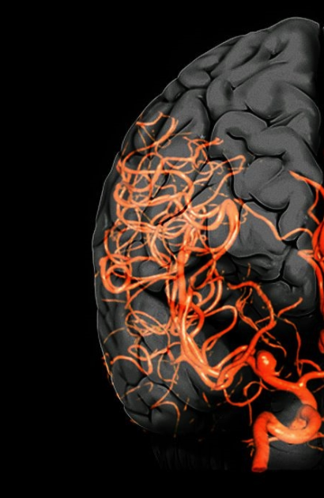
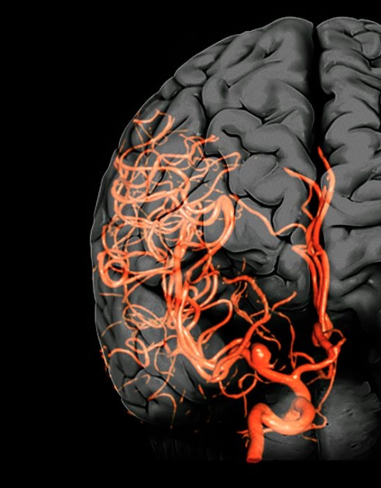

GUIDELINES - Ruptured Intracranial Aneurysms
    Published articles
    Clinical Guidelines/ Standard of care
    Main countries publishing guidelines
    Summary of guidelines
    Guideline limitations

Slide 54
i. Published articles about ruptured intracranial aneurysms - 26.742
2114

Slide 55
ii. Published articles about ruptured intracranial aneurysms (26.742) and Clinical Guidelines (14)
2114

Slide 56
ii. Articles related to clinical guidelines for treatment of ruptured intracranial aneurysms - 14

Slide 57
iii. Most published guidelines for ruptured aneurysms are from US
 | USA | UK | Australia | South Korea | Spain | Japan
2002 |  |  |  |  |  | 1
2006 | 1 |  |  |  | 1
2010 |  |  |  |  | 1
2011 |  |  |  |  | 1
2012 | 1
2014 |  |  |  | 1
2015 | 2 |  | 1
2016 | 2 | 1 |  |  |  | 1

Slide 58
iv. Summary of published clinical guidelines
Generally addressed issues
Risk factors for and prevention of aSAH
Natural history and outcome of aSAH
Clinical manifestations and diagnosis of aSAH
Medical measures to prevent rebleeding after aSAH
Surgical and endovascular methods of treatment of ruptured cerebral aneurysms
Hospital characteristics and systems of care
Anesthetic management during surgical and endovascular treatment
Management of cerebral vasospasm/ hydrocephalus/ seizures/ medical complications after aSAH

Slide 59
v. Guideline limitations
2 out of 52 recommendations have Level A evidence
Based on a single large clinical trial
Not all treatment algorithms are included
No reference to cost!

Slide 60
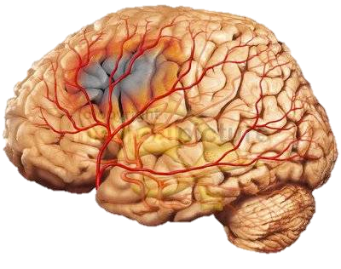
GUIDELINES - Ischemic Stroke
    Published articles
    Clinical Guidelines/ Standard of care
    Summary of guidelines
    Guideline limitations

Slide 61
i. Published articles about ruptured intracranial aneurysms – 79,828
6501

Slide 62
i. Published articles about ischemic stroke (79,828) and Clinical Guidelines (794)
6501

Slide 63
ii. Clinical guidelines for treatment of ischemic stroke - 794

Slide 64
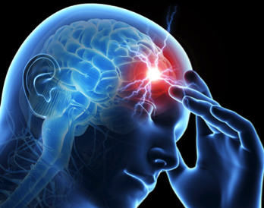
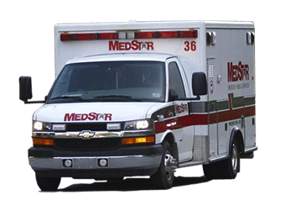
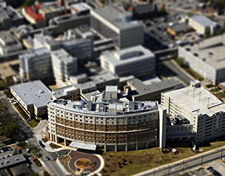
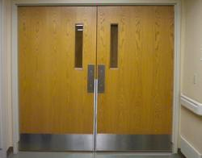

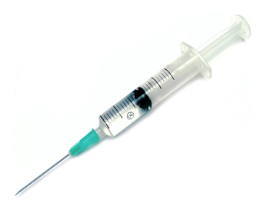
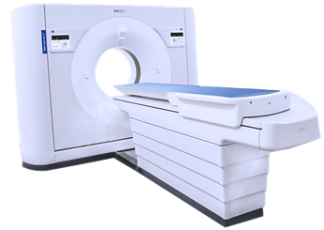
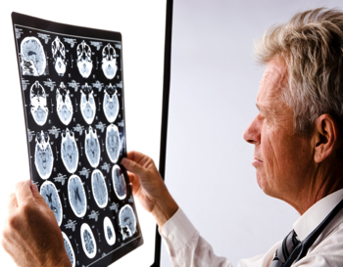
iii. Guidelines of Ischemic stroke treatment
Detection
Dispatch
Delivery
Door
Stroke call
EMS arrival to scene <15m
Stroke Center
Door
<90 sec
ASAP
ASAP
<15min
Angiography Unit
IV t-PA administration
CT/CTA/CTP
ASPECT
Neurologist/
NIHSS
<30 min
<25 min
Device
Drug
Decision
Data
Source: 1.AHA/ASA Guidelines for the Early Management of Patients With Acute Ischemic Stroke.
A Guideline for Healthcare Professionals, 2013
2. 2015 AHA/ASA Focused Update of the 2013 Guidelines
Notes:
http://stroke.ahajournals.org/content/44/3/870
http://stroke.ahajournals.org/content/46/10/3020

Slide 65
DAWN TRIAL
Clot retrieval between 6-24 hours after onset of symptoms significantly decreased post-stroke disability and improved functional independence at 90 days, a relative reduction of 73%.

Slide 66
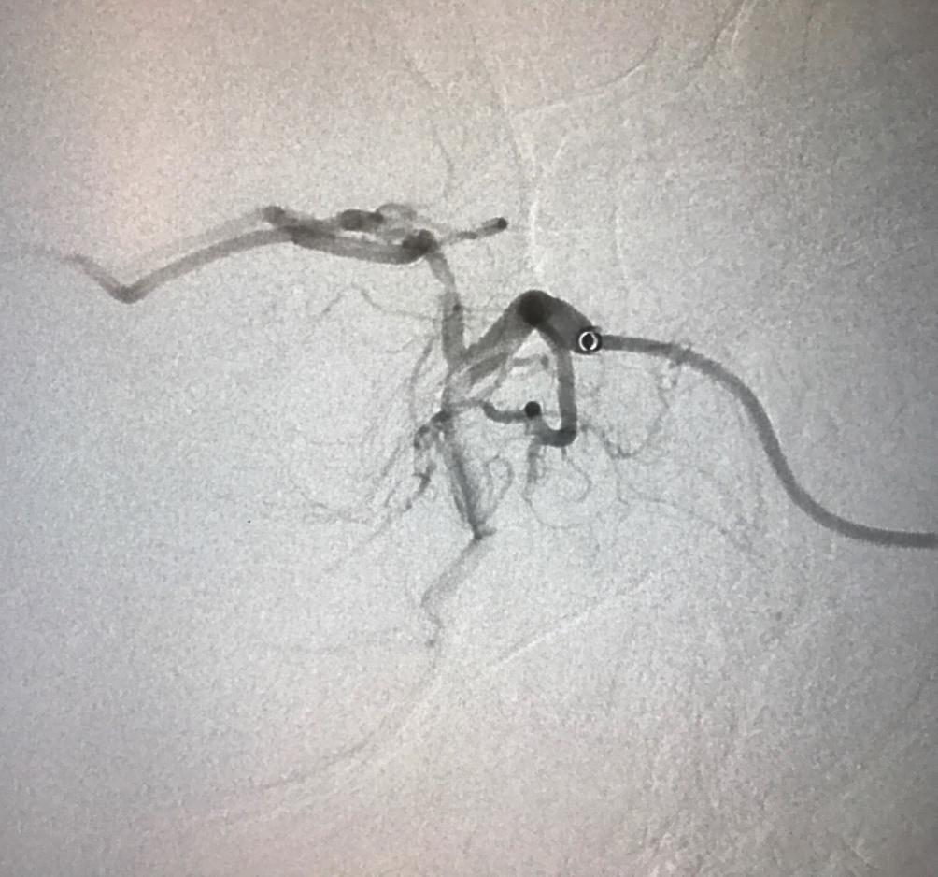
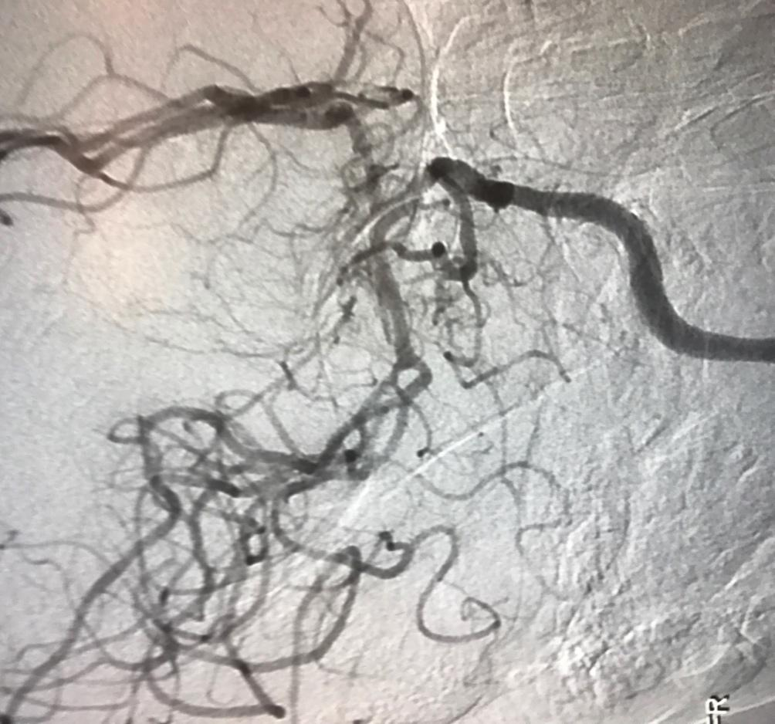
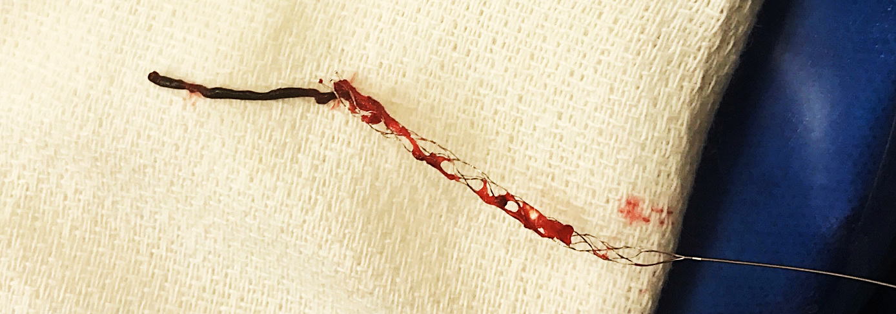

Slide 67
iii. Evidence in acute ischemic stroke treatment guidelines
25 out of 116 recommendations have Level A evidence
No reference to cost!

Slide 68
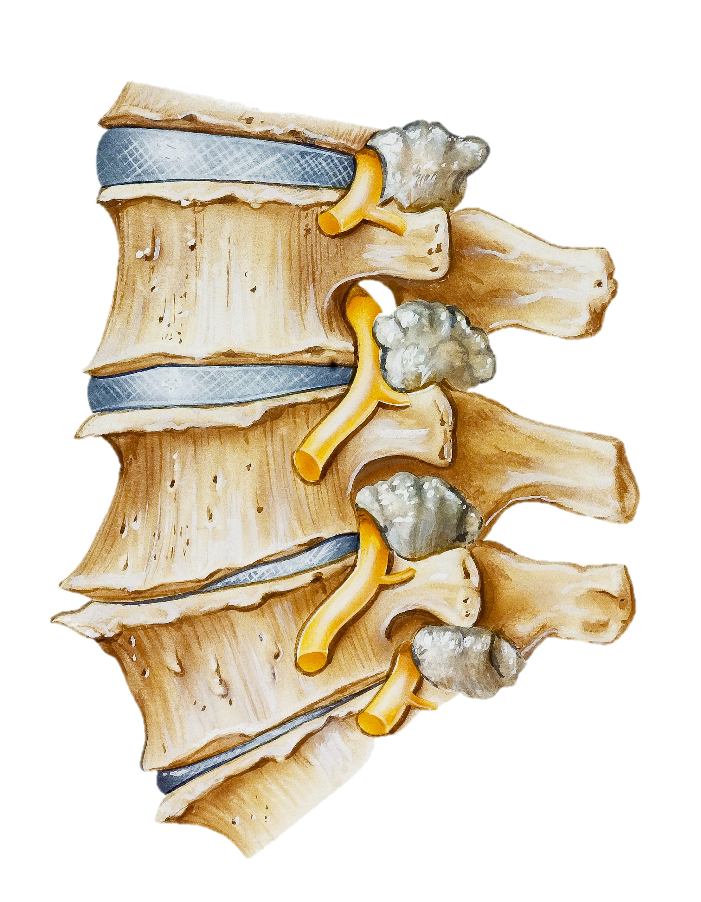
GUIDELINES - Degenerative spine disease
    Published articles
    Clinical Guidelines/ Standard of care
    Summary of guidelines
    Guideline limitations

Slide 69
i. Published articles about degenerative spine disease – 190,946
11062

Slide 70
i. Published articles about degenerative spine disease (190,946) and Clinical Guidelines (7)
11062

Slide 71
ii. Guideline limitations
Level A evidence (3 out of 241 recommendations)
  unenhanced CT has limited diagnostic value
  MRI without clinical correlation has limited diagnostic value
  In lumbar stenosis, blind interlaminar injection is correct in 83% of cases
No reference to cost!
Notes:
https://www.spine.org/Documents/ResearchClinicalCare/Guidelines/LumbarStenosis.pdf

Slide 72
GUIDELINES - SUMMARY
Disease | Number of published articles | Published guidelines | Level I recommendations
Glioblastoma | 28,577 | 40 | 4
Subarachnoid hemorrhage | 26,742 | 14 | 2
Ischemic stroke | 79,828 | 794 | 25
Degenerative spine disease | 190,946 | 7 | 3
Scarce Level 1 evidence
No reference to cost!

Slide 73
Despite the shortfalls of the clinical guidelines we will now assess:
BENEFIT OF GUIDELINES
COST

Slide 74
BENEFIT OF GUIDELINES
COST
Missing variables

Slide 75
Missing variables in the analysis
Therapeutic complications
Loss of ability to work
Disability and aftercare expenses
Family care commitments and bereavement
Typical age of onset for each disease process
Structural expenses for emergency care system
Also…
Research advantages – may discover causal factors
Social contract
Moral issues

Slide 76
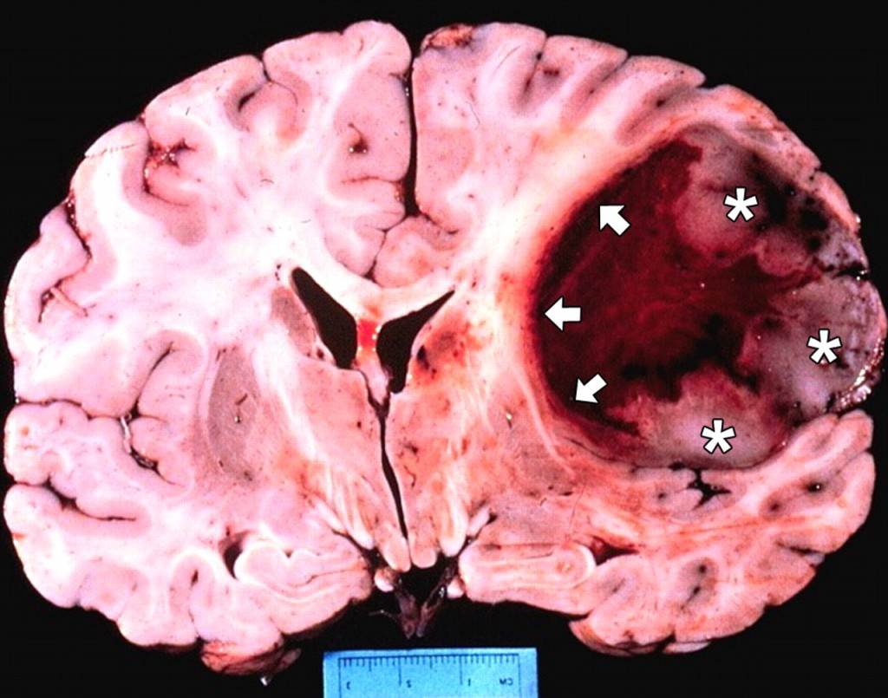
BENEFIT OF GUIDELINES - Glioblastoma

Slide 77
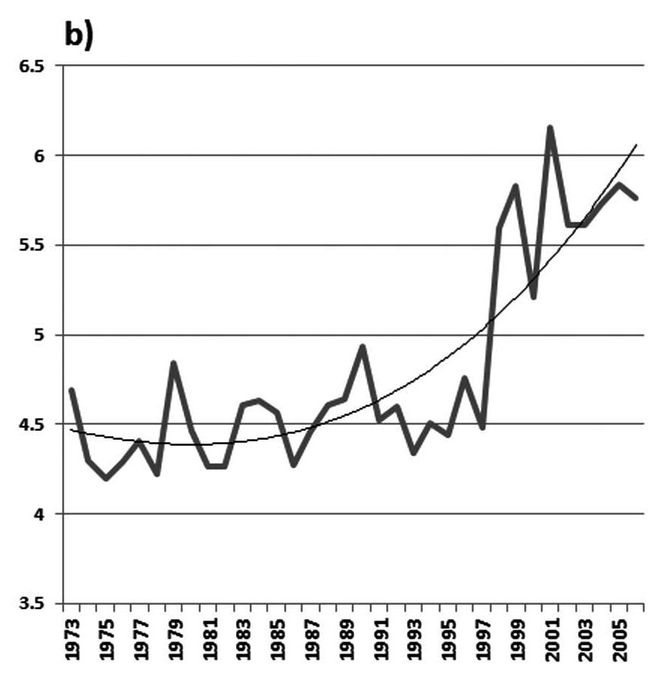
Survivability in GBM
Kaplan-Meier plot, 21,783 GBM patient yearly median survival development over time
Pascal O. Zinn et al., 2013
Notes:
https://www.spandidos-publications.com/ijo/42/3/929

Slide 78
Survivability in GBM
Median survival without treatment is 3 months¹
Median survival with maximal treatment is 14.6 months²
Treatment adds 11,6 months or about 1 year of life
1. Schapira, Anthony H.V. (2007). Neurology and clinical neuroscience.
Philadelphia: Mosby Elsevier. p. 1336. ISBN 9780323070539.
2. World Cancer Report 2014. World Health Organization.
2014. pp. Chapter 5.16. ISBN 9283204298.
Notes:
https://en.wikipedia.org/wiki/Glioblastoma

Slide 79
BENEFIT OF GUIDELINES – Ruptured Intracranial Aneurysms

Slide 80
Outcome – Ruptured Intracranial Aneurysms
75%
32%
Notes:
http://emedicine.medscape.com/article/1164341-overview#a7

Slide 81
Outcome – Ruptured Intracranial Aneurysms
Primary impact
Decrease in mortality – 43%
Decrease in disability – 27%
Mean age at presentation – 55.74
Proper treatment can add about 20 years of productive life

Slide 82
BENEFIT OF GUIDELINES – Ischemic Stroke

Slide 83
Outcome – Ischemic Stroke
Aspirin immediately after stroke
Decrease in mortality – 1%
tPA<3 hours
No change in mortality
Decrease in disability– 12%
Addition of thrombectomy <6 hours (MR CLEAN)
Decrease in mortality – 1%
Decrease in disability – 16%
Thrombectomy 6-24 hours
Decrease in mortality - 10%
Decrease in disability – 32%
Mean age at presentation – 65 years old
Notes:
http://www.strokecenter.org/patients/about-stroke/stroke-statistics/

Slide 84
BENEFIT OF GUIDELINES – Degenerative spine diseases

Slide 85
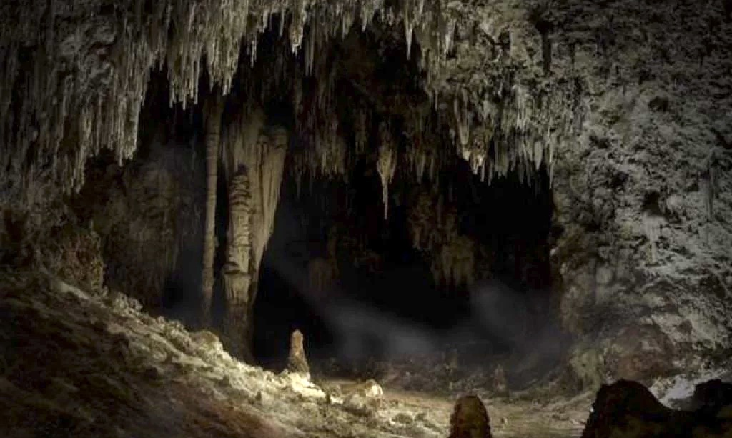
Outcome is not well investigated

Slide 86

TREATMENT COST

Slide 87
Cost data is quite arbitrary and subject to substantial change.

Slide 88
Approximate gross treatment expenses in the US
Source: GlobalData, Medscape, CDC, Kindrachuk et al.

Slide 89
TREAMTENT COST- Glioblastoma

Slide 90
TREAMTENT COST- Glioblastoma
USA
Neurosurgery consultation - $378
Labs - $400
Imaging (MRI) – 6 x $600
Hospital costs - $8.813
Surgery costs - $25.204
BCNU costs - $10.000
Genetic study - $550
Immunohistology - $416
Radiation costs - $11.520
TMZ (initial) - $12.136
TMZ (maintenance) - $2.041/month
Electric field therapy - $21.000/month
Other medications - $300/month
Hospice - $4.500/month
Total: about $250.000
INDIA
Neurosurgery Consultation - $11
Labs - $119
Imaging (MRI) – 6 x $400
Hospital costs - $467
Surgery costs - $3.500
BCNU costs - $4.285
Genetic study - $243
Immunohistology - $124
Radiation costs - $6.898
TMZ (initial) - $1.410
TMZ (maintenance) - $365/month
Electric field therapy - NA
Other medications – $180/month
Hospice – NA
Total: about $27.414

Slide 91
TREATMENT COST - Ruptured Intracranial Aneurysms

Slide 92
TREATMENT COST - Ruptured Intracranial Aneurysms
Richard Dodel et al., Stroke. 2010;41:2918-2923
Notes:
http://stroke.ahajournals.org/content/41/12/2918

Slide 93
TREATMENT COST – Ischemic Stroke

Slide 94
TREATMENT COST – Ischemic Stroke
Acute management of Ischemic Stroke
IV tPA alone - $19,000
Thrombectomy - $34,000

Slide 95
TREATMENT COST – Degenerative spine disease

Slide 96
The “National Bill” of All Spine De Novo Fusions and Refusions

Slide 97
BENEFIT OF GUIDELINES
COST
Summary
Disease | Average cost | Benefit of guidelines | Cost/QALY
Glioblastoma | ≈$250,000 | Extended survival for about 1 year | $256,000
Subarachnoid hemorrhage | ≈$41,905 | Decreased mortality –43% Decreased disability* –27% | $4,862
Ischemic stroke | tPA ≈$19,000 Thrombectomy ≈$34,000 | Decreased mortality: 2-10% Decreased disability*:12-32% | $24,000 Cost saving
Spinal fusion | $18,000-$44,000 | ??? | ???
*Modified Rankin Scale ≥3
Notes:
http://stroke.ahajournals.org/content/strokeaha/43/4/1131.full.pdf
https://www.ncbi.nlm.nih.gov/pmc/articles/PMC4933608/
http://www.toyourhealth.com/mpacms/tyh/article.php?id=1447

Slide 98
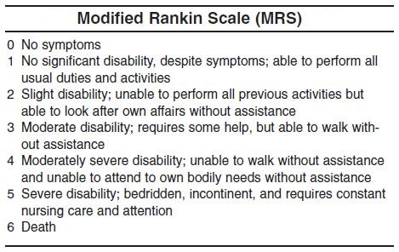

Slide 99



An illustration/years of useful life
VS
VS
VS ??
Glioblastoma
Spine
Subarachnoid Hemorrhage
Ischemic stroke
If the same amount of money spent on acute treatment in each disease category – this will be the relative benefit in increased years of useful life.

Slide 100
DISCUSSION
Early diagnosis (better markers of risk)
Prevention
Patient responsibility

Slide 101
1. Early diagnosis
Cost/year
MRI with
contrast
$4,000
Glioblastoma
MRA
SAH
Carotid US, EKG
$1,200
Ischemic Stroke
DEXA scan,
Lumbar X-ray
$550
$385
Spine
Age
0 10 20 30 40 50 60 70 80 90

Slide 102
Early diagnosis of intracranial aneurysms analysis in Armenia
Prevalence of unruptured aneurysms on autopsies – 1,6%
Number of people who are 25 years old – 58,000 (CIA world factbook)
Cost of MRA - $100
Universal screening of all 25 year-old people by MRA will cost $5,800,000
It would reveal 928 aneurysms per year (18 operations per week)
Cost of aneurysm treatment - $8,000
Cost of treatment for 928 patents – $7,424,000
Total cost of prevention - $13,224,000/year
Notes:
https://www.ncbi.nlm.nih.gov/pubmed/2244298

Slide 103
However…
Expanding an earlier useful inquiry

Slide 104

Framingham Heart Study
Framingham

Slide 105
Framingham Heart Study
Project of the National Heart, Lung, and Blood Institute
A long-term, ongoing cardiovascular screening study on residents of the town of Framingham, Massachusetts.
Began in 1948
5,209 adult subjects from Framingham
Currently involves the third generation of participants.
Revealed the effects of diet, exercise, and common medications such as aspirin.
The Framingham Heart Study and the epidemiology of cardiovascular disease: a historical perspective, Mahmood, Syed S et al., The Lancet , Volume 383 , Issue 9921 , 999 – 1008

Slide 106

2. Prevention
The affordable care act
An occasional good idea

Slide 107
---- Ischemic Stroke
---- Subarachnoid Hemorrhage
---- Spine
Severity of the disease
Red Zone: Severe enough to require acute treatment
No Prevention
Prevention/early diagnosis
No Prevention
Prevention/early diagnosis
0 10 20 30 40 50 60 70 80
Age
* Implication is we understand the cause
Notes:
GBM - http://cebp.aacrjournals.org/content/23/10/1985
Ischemic Stroke - http://stroke.ahajournals.org/content/32/12/2741
SAH- http://stroke.ahajournals.org/content/31/8/1843
DDD- http://ard.bmj.com/content/73/6/968

Slide 108
Non exhaustive cost of prevention
Cost/year
No effective prevention of Glioblastoma
$42.000
Treatment of Aneurysm
SAH
Warfarin
$1,200
Ischemic Stroke
Vit D, Calcium
$40
Spine
Aspirin
$15
Age
0 10 20 30 40 50 60 70 80 90

Slide 109
Some preventive measures decrease the risk of multiple diseases – non exhaustive list
 | Glioblastoma | Ischemic Stroke | SAH | Spine diseases | Cost/year
Smoking | ✔ | ✔ | ✔ | ✔ | $0
Obesity |  | ✔ |  | ✔ | $0
Diabetes |  | ✔ | ✔ | ✔ | $7,900 ?
Hypertension |  | ✔ | ✔ |  | $850 ?
Preventive Medications |  | ✔ | ✔ | ✔ | $15-$1,200 ?

Slide 110
A controversial UK solution – patient responsibility

Slide 111
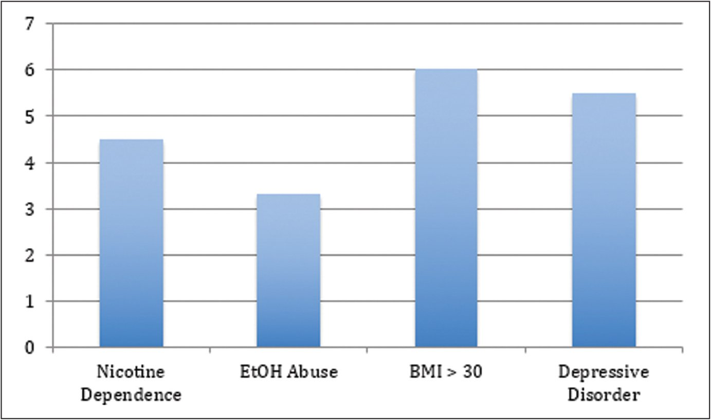
Relative risks for modifiable risk factors in Degenerative Disc Disease
Source: Modifiable Risk Factors in Patients With Low Back Pain; Scott T. Shemory, MD; Kiel J. Pfefferle, MD; Ian M. Gradisar, MD; Orthopedics; June 2016 - Volume 39, Issue 3: e413-e416

Slide 112
BMI >30 is a factor of poor outcomes in elective spinal surgery.
🡹 rates complications (odds ratio 1.6; 95% CI - 1.1-2.3)
🡹 rates of readmission (odds ratio 2.3; 95% CI - 1.1-4.9)
🡹 rates of return to the operating room (odds ratio 1.8; 95% CI - 1.1-3.1)
Source: Impact of increased body mass index on outcomes of elective spinal surgery. Seicean A, Alan N, Seicean S, Worwag M, Neuhauser D, Benzel EC, Weil RJ. Spine. 2014 Aug 15;39(18):1520-30.

Slide 113
Return-To-Work Rate of Smokers vs. Non-Smokers
51% - smokers
68% - quit smoking > 1 after surgery
77% - > 6 months after surgery
71% - non-smokers
Source: The effect of cigarette smoking and smoking cessation on spinal fusion; S D Glassman; S C Anagnost; A Parker; D Burke; J R Johnson; J R Dimar; Spine. 25(20):2608-15, OCT 2000

Slide 114

UK NHS indefinite surgery ban for smokers and obese
Formerly
  Elective operations were delayed for months, during which time such patients were expected to try to lose weight or stop smoking.
Now
  The NHS will ban patients from surgery indefinitely unless they lose weight or quit smoking
  Smokers will only be referred for operations if they have stopped smoking for at least eight weeks
  Patients with a BMI >30 will only be referred for operations if they reduce their weight by 10% and with a BMI >40 by 15% over 9 months.

Slide 115

Patient responsibility
UK NHS indefinite surgery ban for smokers and obese

Slide 116
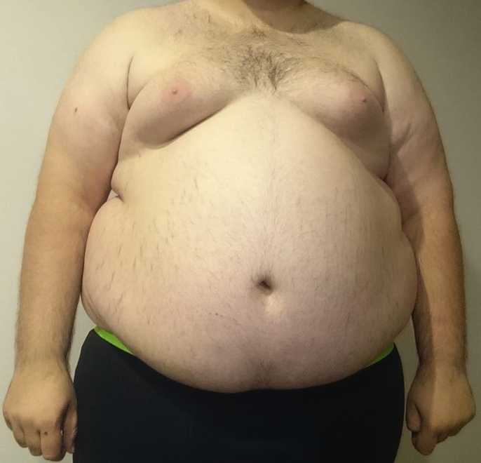
Patient responsibility
UK NHS indefinite surgery ban for smokers and obese

Slide 117
CONCLUSION
Inadequate clinical guidelines with no reference to cost data in acute therapeutic intervention.
Despite the extraordinary expense of spine fusions there is no reliable benefit data.
By far the most cost-effective intervention is Ischemic Stroke > SAH > Glioblastomas
For some disease processes early diagnosis would be cost effective
Prevention is by far the most cost effective mechanism to reduce treatment expenses.
Effective prevention requires enhanced patient responsibility.

Slide 118

THANK YOU

